Slide 1
Hands-on NodeJS + JavaScript + Debug (Chrome / IntelliJ) + TypeScript
arnaud.nauwynck@gmail.com
Esilv 2024
This document: https://github.com/Arnaud-Nauwynck/presentations/tree/main/web/tp1-nodejs.pdf

Slide 2
Objectives
Discover NodeJs using practical « Hello World » developper code
Using Simple baby steps, step by step
Setup your web environment
Become familiar with the Web FrontEnd ecosystem

Slide 3
Outline
Download + Install NodeJs
Run NodeJS from the command line
Discover and run basic javascript program
Discover NPM Node Package Manager
Install package.json dependencies
Install WebStorm IDE (students may choose any IDE, VisualStudio Code)
Debug Javascript program
TypeScript to JavaScript from the IDE
Tsc compiler
Debug TypeScript

Slide 4
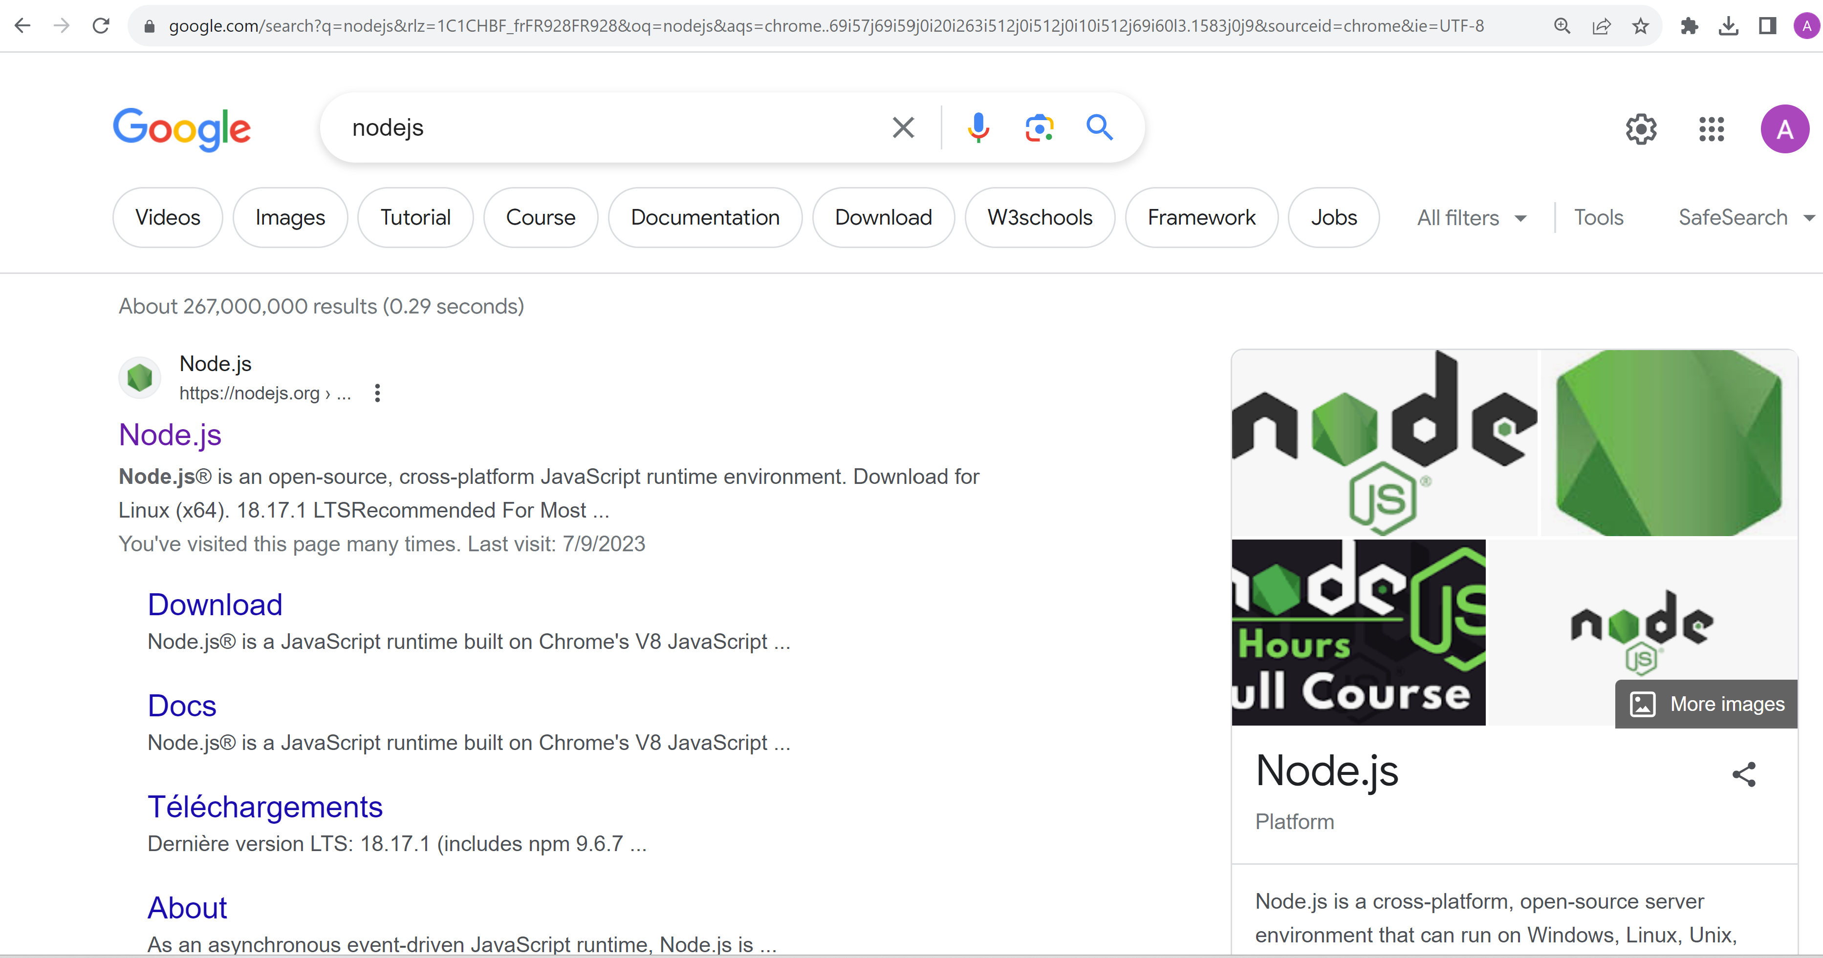
Google NodeJs

Slide 5
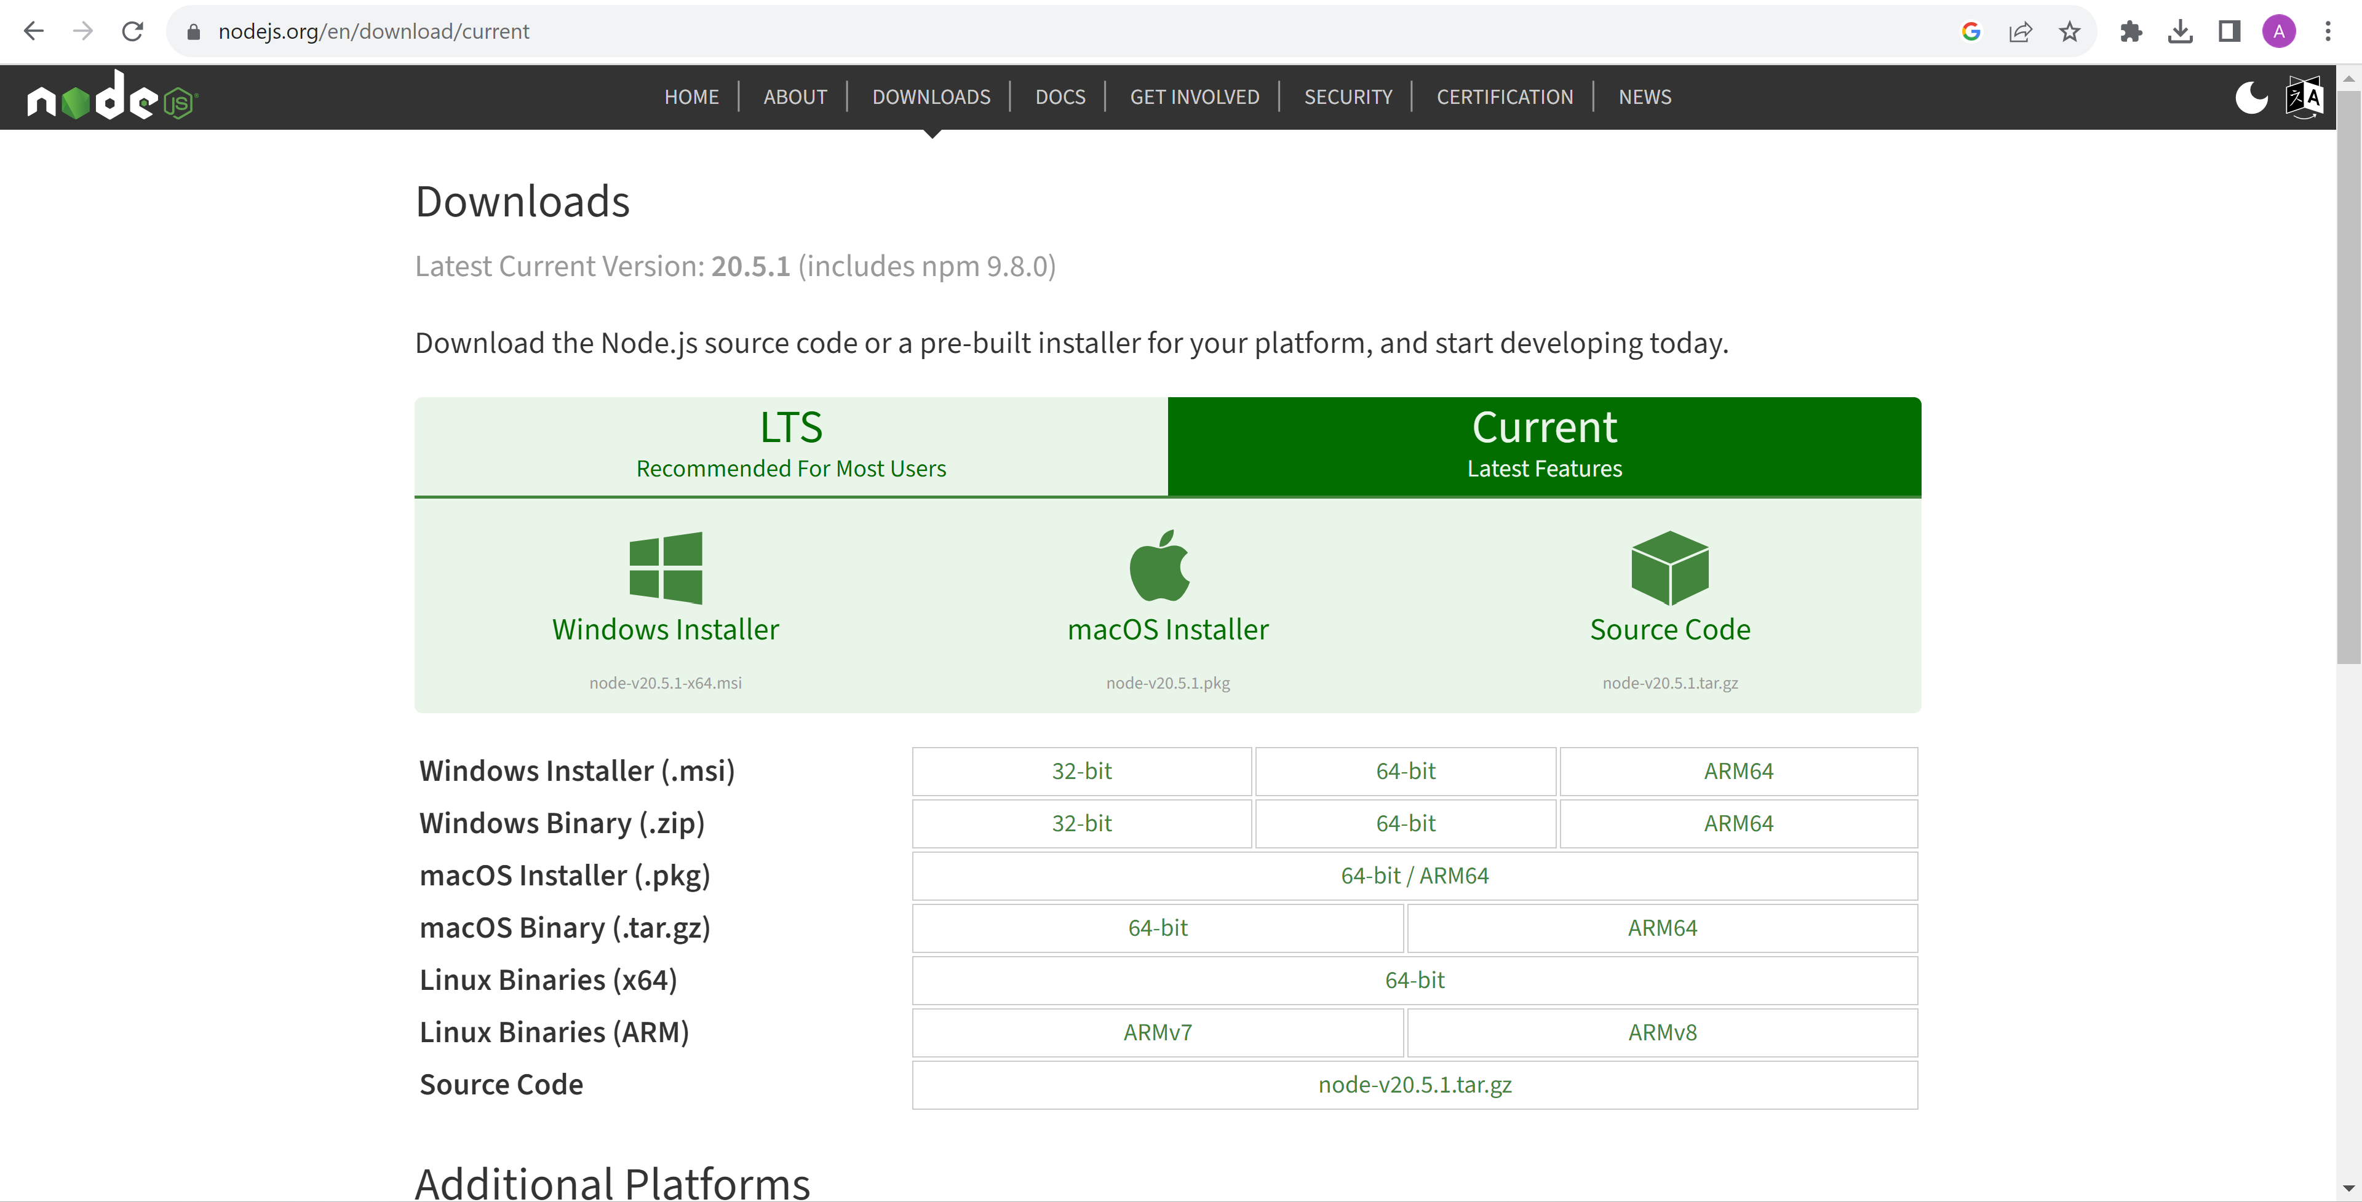
Download NodeJs

Slide 6
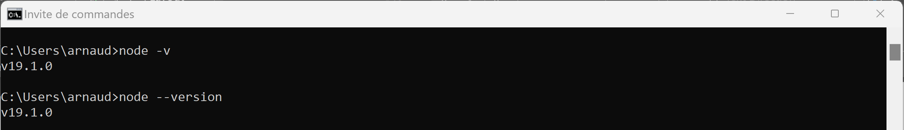
Check NodeJs exe (check version) C:> node -v

Slide 7
if "node.exe" just works
(automatically added to PATH environment variable by your installer)
=> skip next slides marked as
System Diagnostic

Slide 8
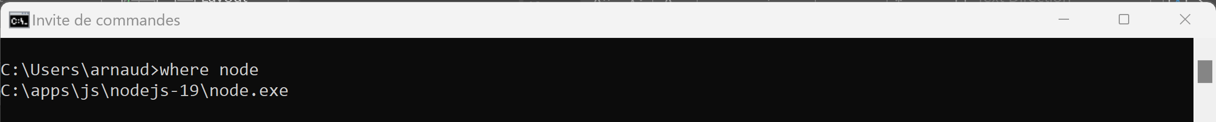
Several installed ? … which one will be resolved C:> where node
System Diagnostic

Slide 9
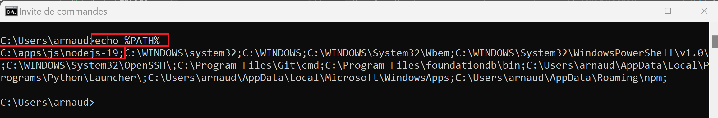
Check NodeJS is in « %PATH% »(win cmd terminal) echo %PATH%
System Diagnostic

Slide 10
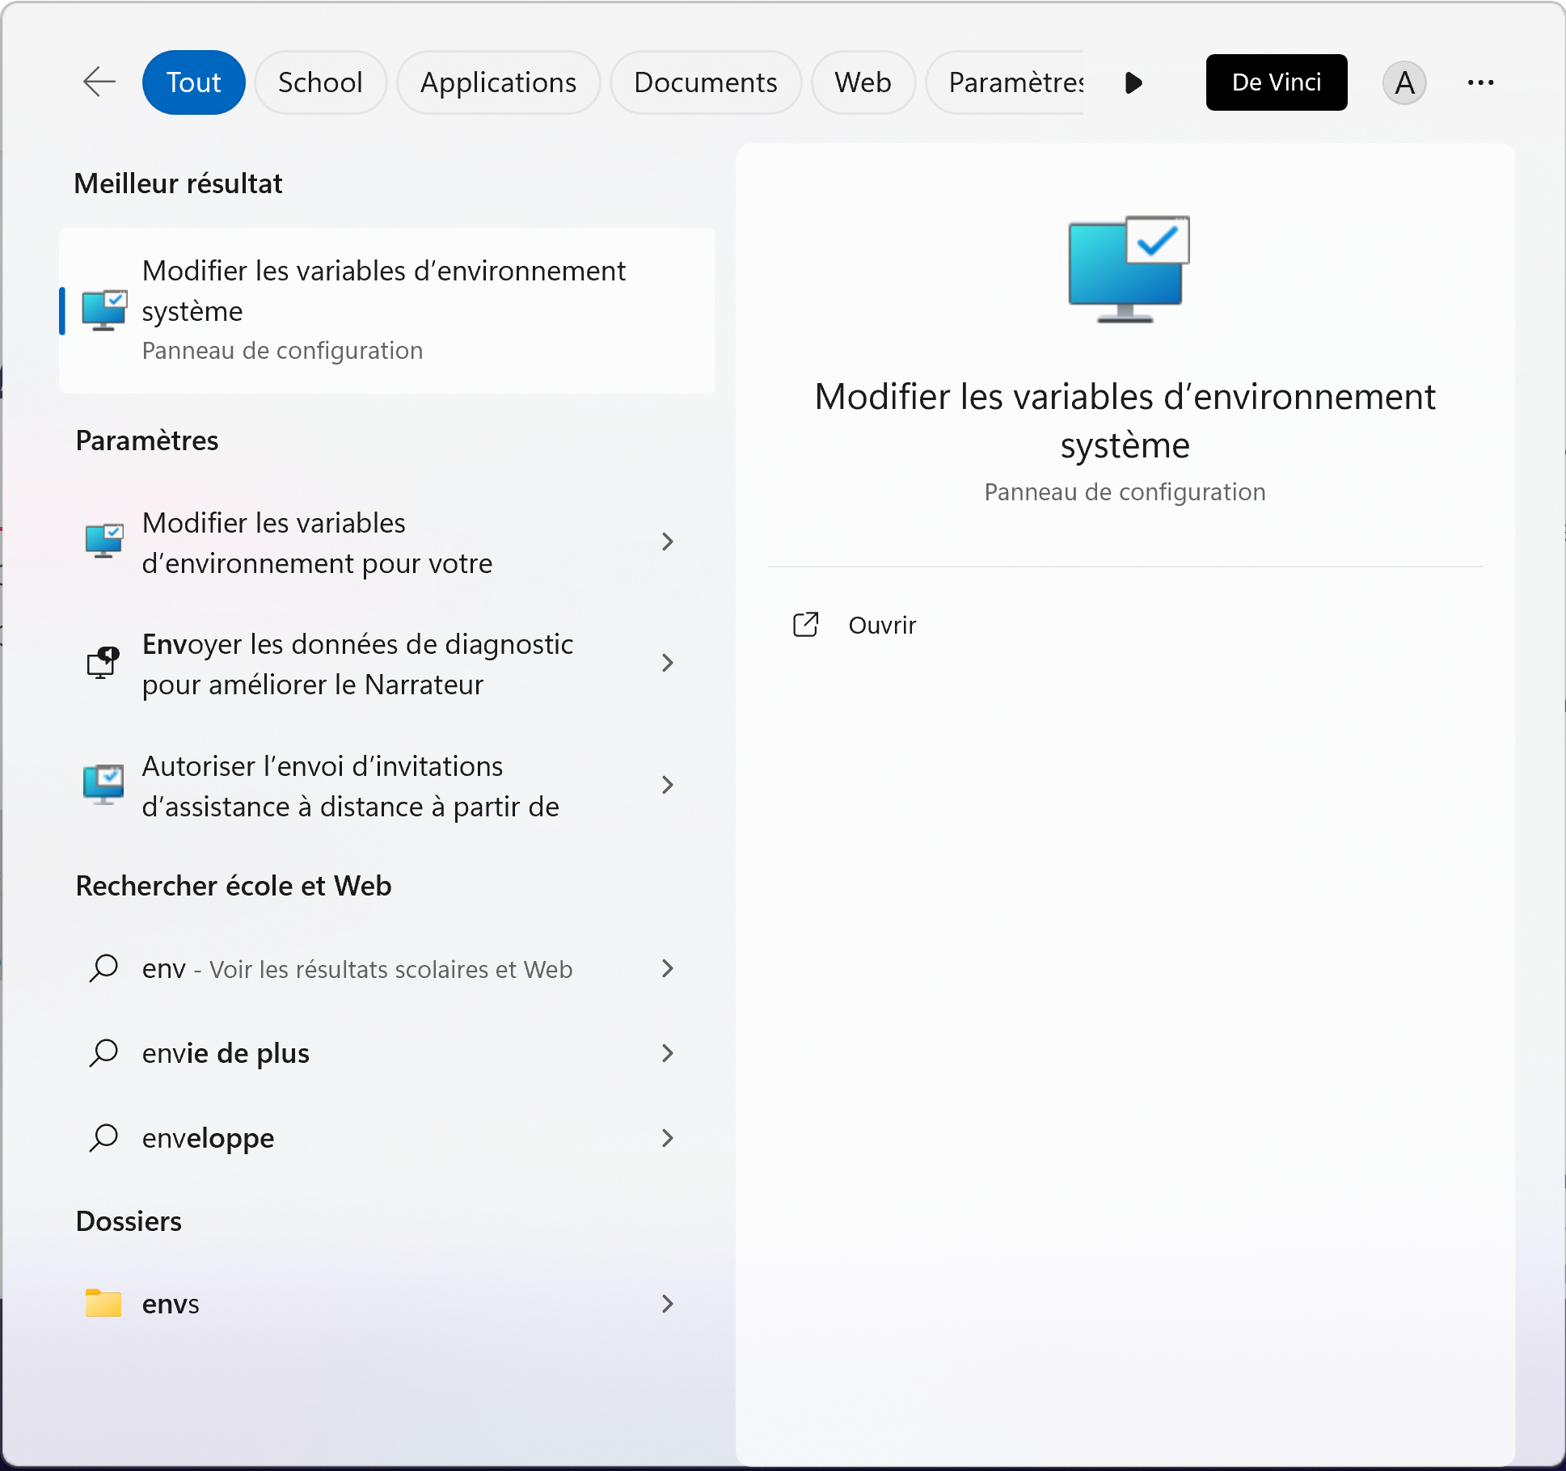
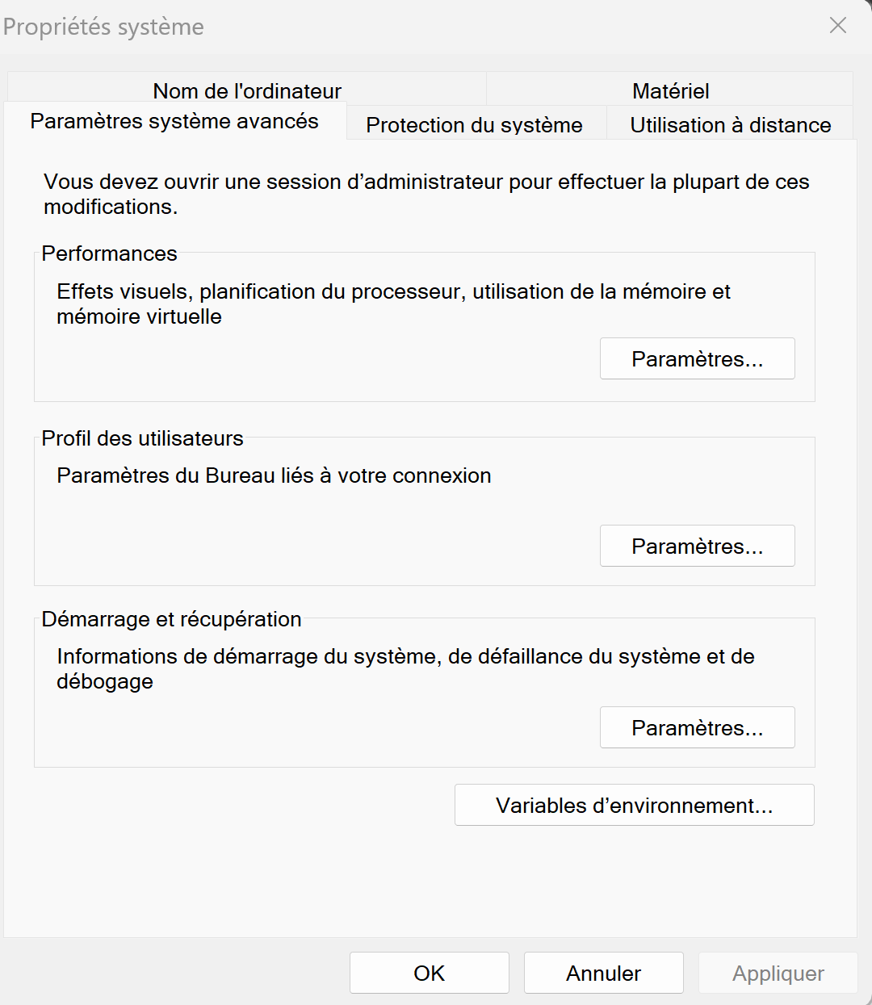
Edit System or User Environment Variables
System Diagnostic

Slide 11
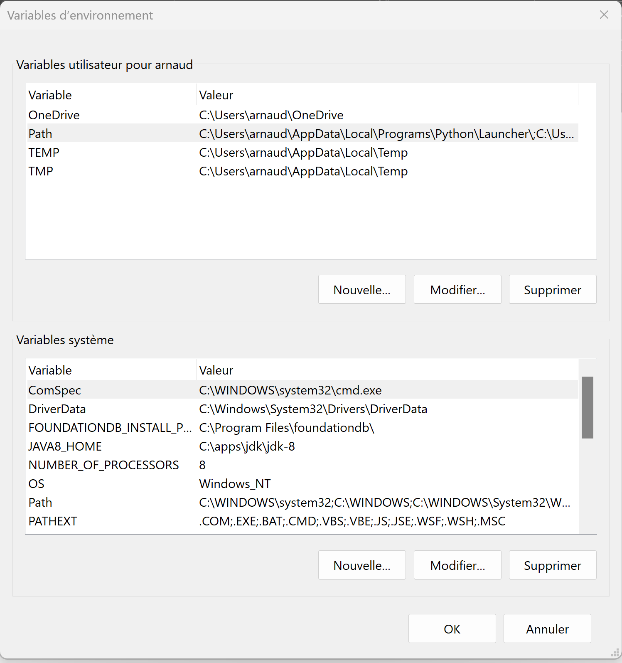
Edit {user|system} PATH environment variable
System Diagnostic

Slide 12
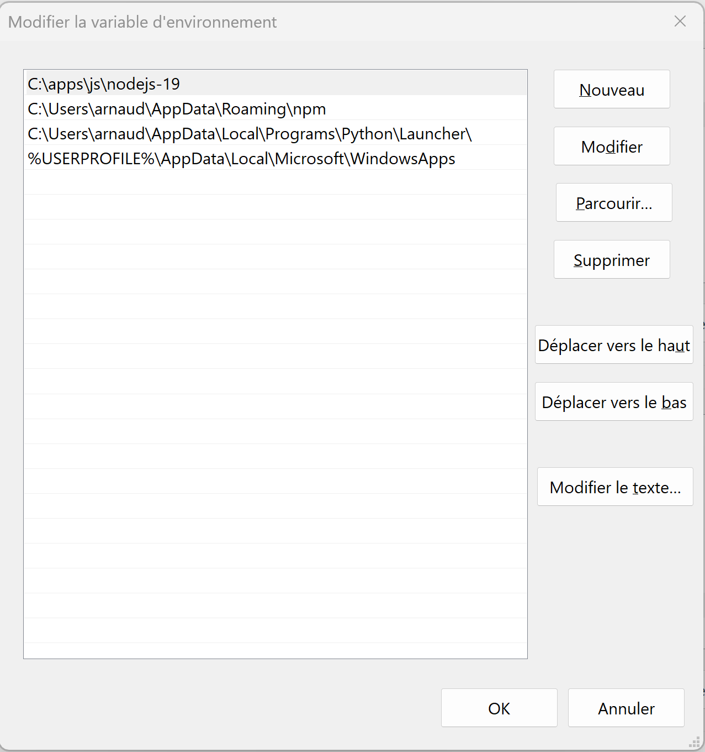
Prepend(=max priority) or Append to PATH
System Diagnostic
Then restart
your terminals & apps !!
( env vars are inherited during program starts )

Slide 13
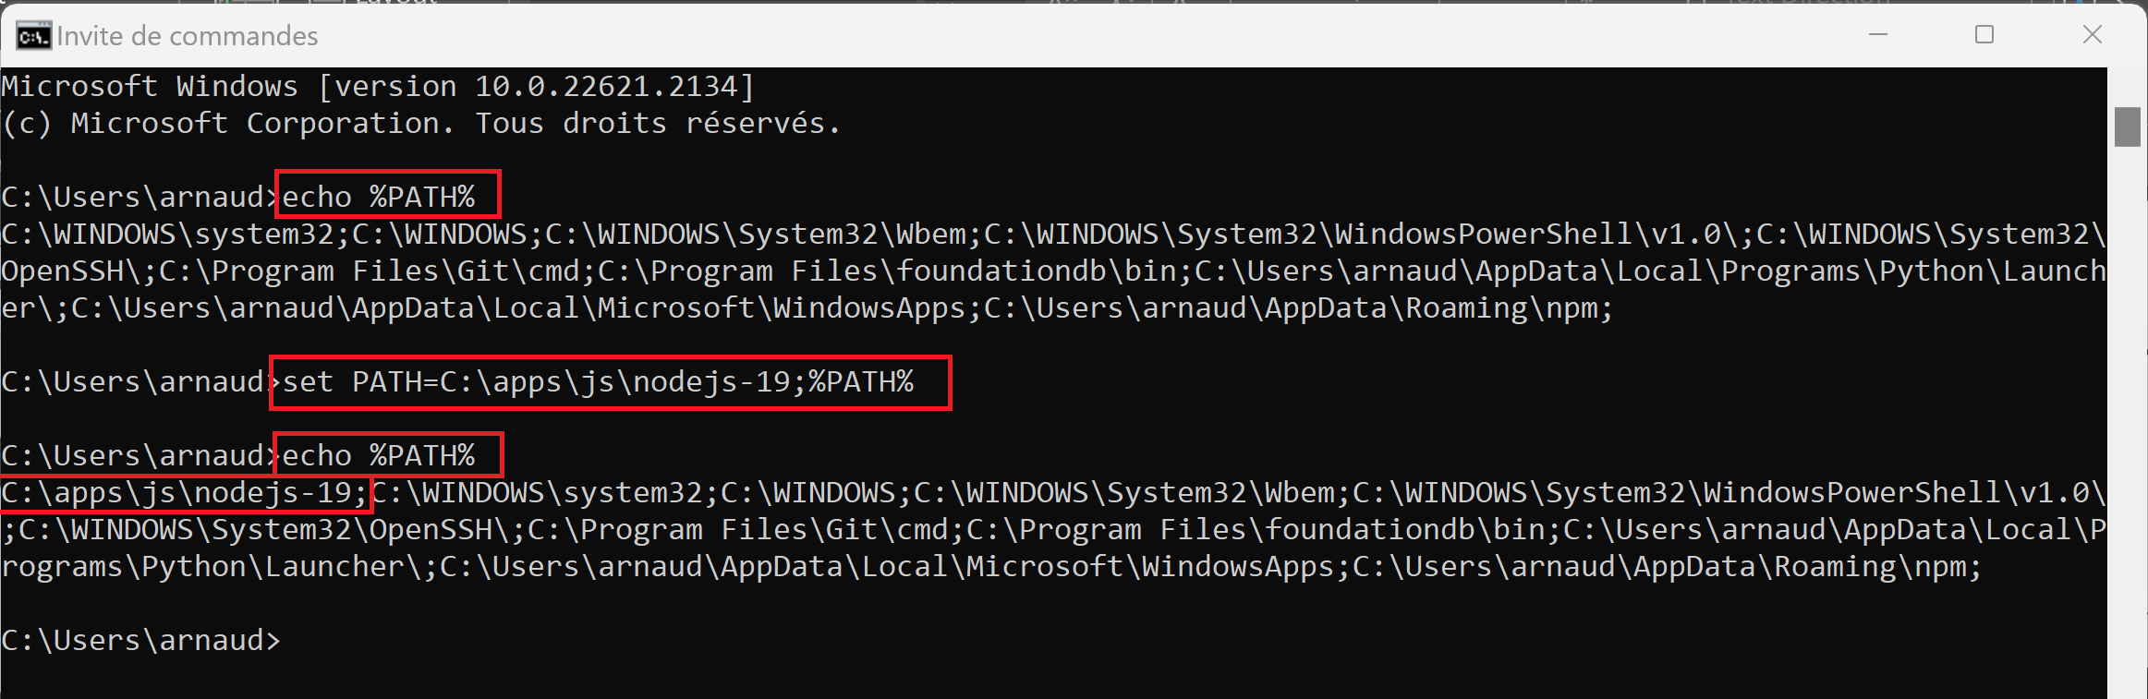
Override in terminal to add in « %PATH% » ( may edit + call setenv.cmd) set PATH=c:\your-node-dir;%PATH%
System Diagnostic

Slide 14
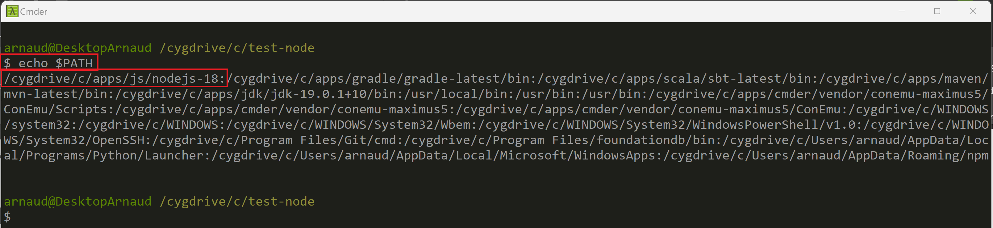
Case 2… using Cmder > Bash$ Check NodeJS « $PATH » echo $PATH
System Diagnostic

Slide 15
Case 2 … using Cmder Bash, Adding in $PATH ( may edit in your $HOME/.profile or .bashrc ) export PATH=/c/your-node-dir:$PATH
System Diagnostic

Slide 16
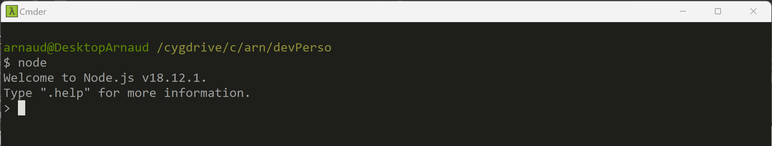
Start NodeJs interactive prompt C:> node

Slide 17
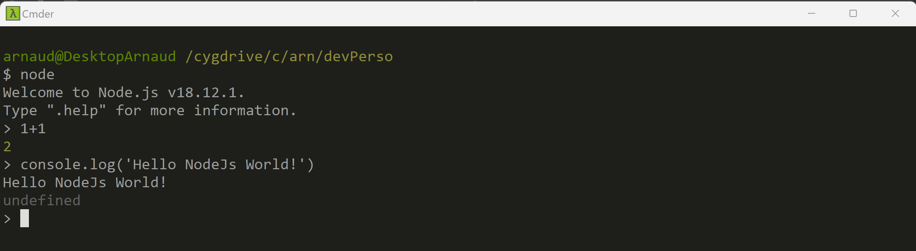
Play with interactive Javascript eval 1+1 console.log(‘Hello’)

Slide 18
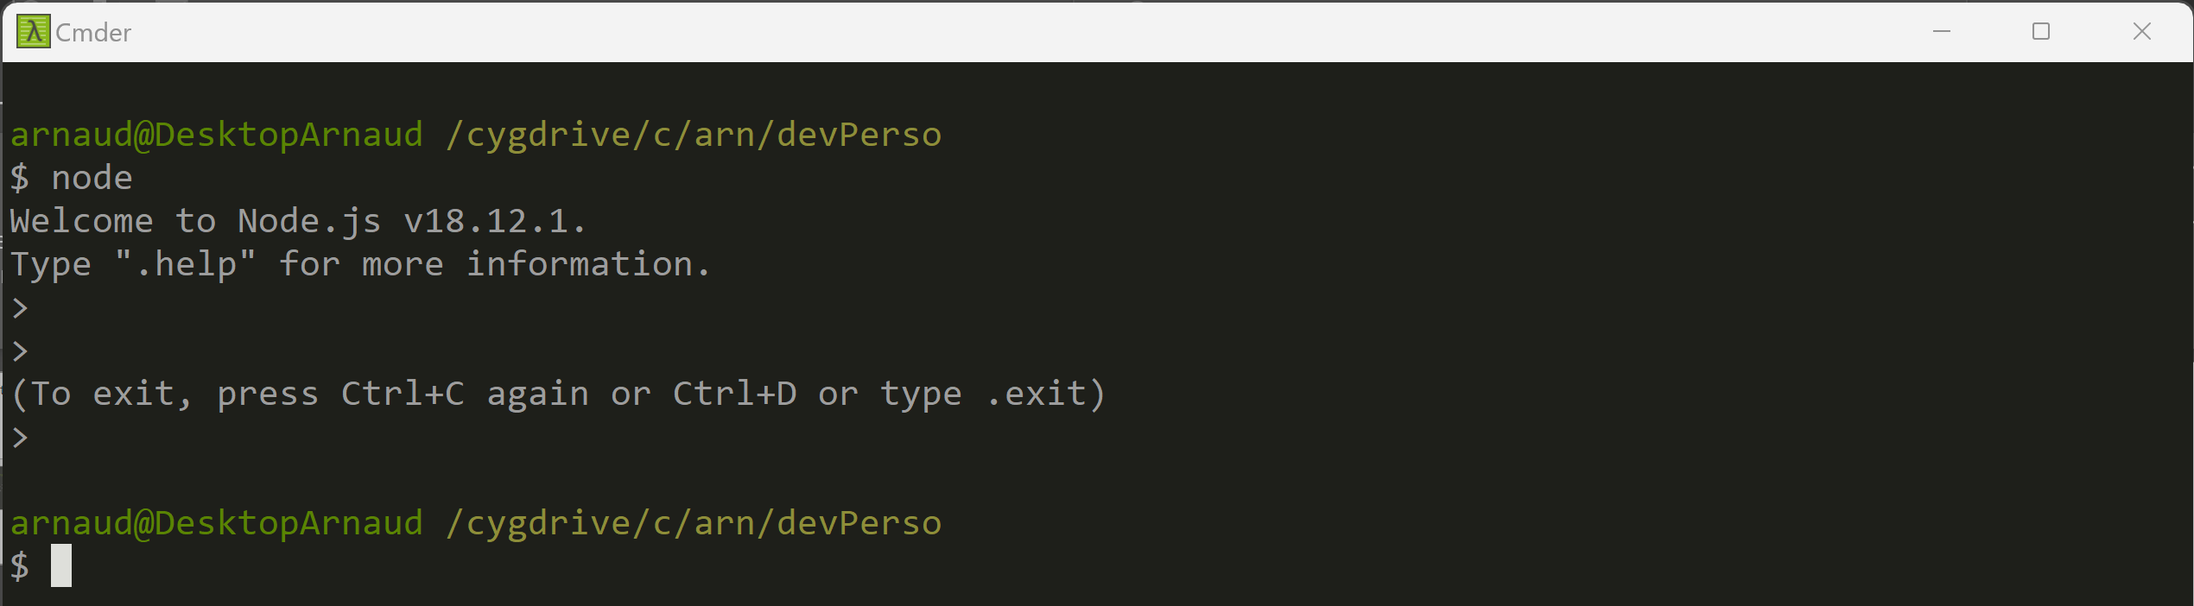
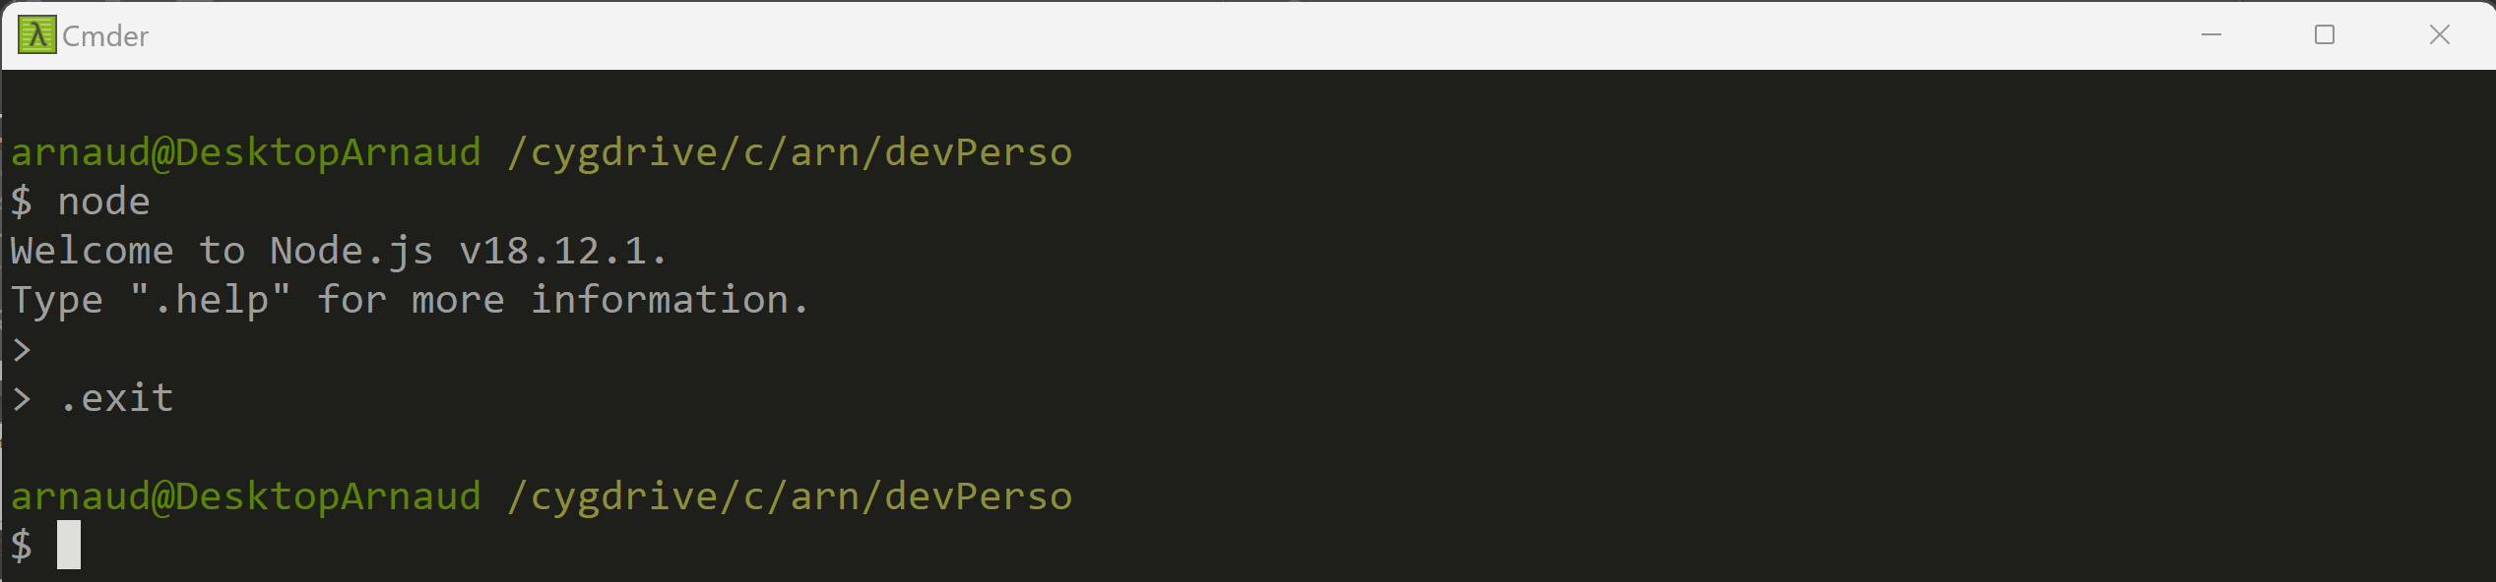
Stop Prompt … Ctrl+C Ctrl+C or .exit

Slide 19
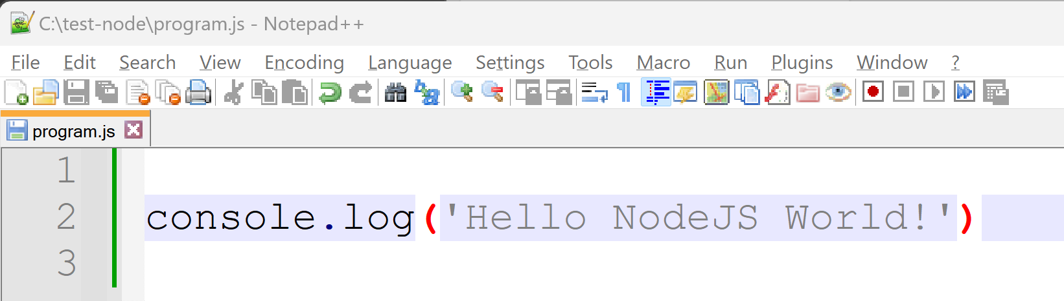
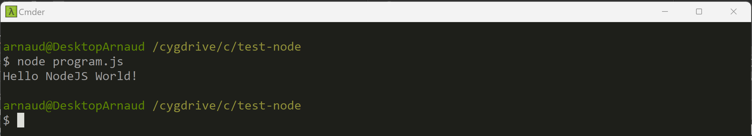
Start NodeJs on a « program.js » file C:> node program.js

Slide 20
using Export then Import [1/5]
Write a program using several *.js files:
export a function from file "my-util.js",
import in file "app.js", and call it

Slide 21
using Export then Import [2/5] : util.js ... the "export" part
Notice there are several possible syntaxes to do the export !
1/ using legacy NodeJs specific syntax function myExportedFunc() { ... }
module.exports = { myExportedFunc };
2/ OR newer standard
export myExportedFunc () { ... }
There can be several named exported symbols, or a default one.
The symbol can be a function, an object, a value (a constant / global), etc.

Slide 22
using Export then Import [3/5] : app.js ... the "import" part
Notice there are several possible syntaxes to do the import
1/ using legacy NodeJs specific syntax const moduleAlias = require("filename");
moduleAlias.myExportedFunc();
2/ OR newer standard when
import {myExportedFunc } from 'filename';
myExportedFunc();

Slide 23
using Export then Import [4/5] ... being compatible with W3C Spec
If you choose the correct way : compatible with W3C Spec
i.e. using standard ECMAScript Module,
"import { ..} from .. "
instead of
".. = require(..)"
=> Then you can re-use the same code in backend(NodeJS) & Front-end Web Browser (Chrome)
The code is simpler / better

Slide 24
using Export then Import [5/5]
Find doc by yourself
ask ChatGPT / Google / NodeJS doc / Standard W3C Specification
what are "NodeJS module" compared to "ECMAScript module" ?
What is module System (CommonJS, ..) ?
What is "node_modules" path ?

Slide 25
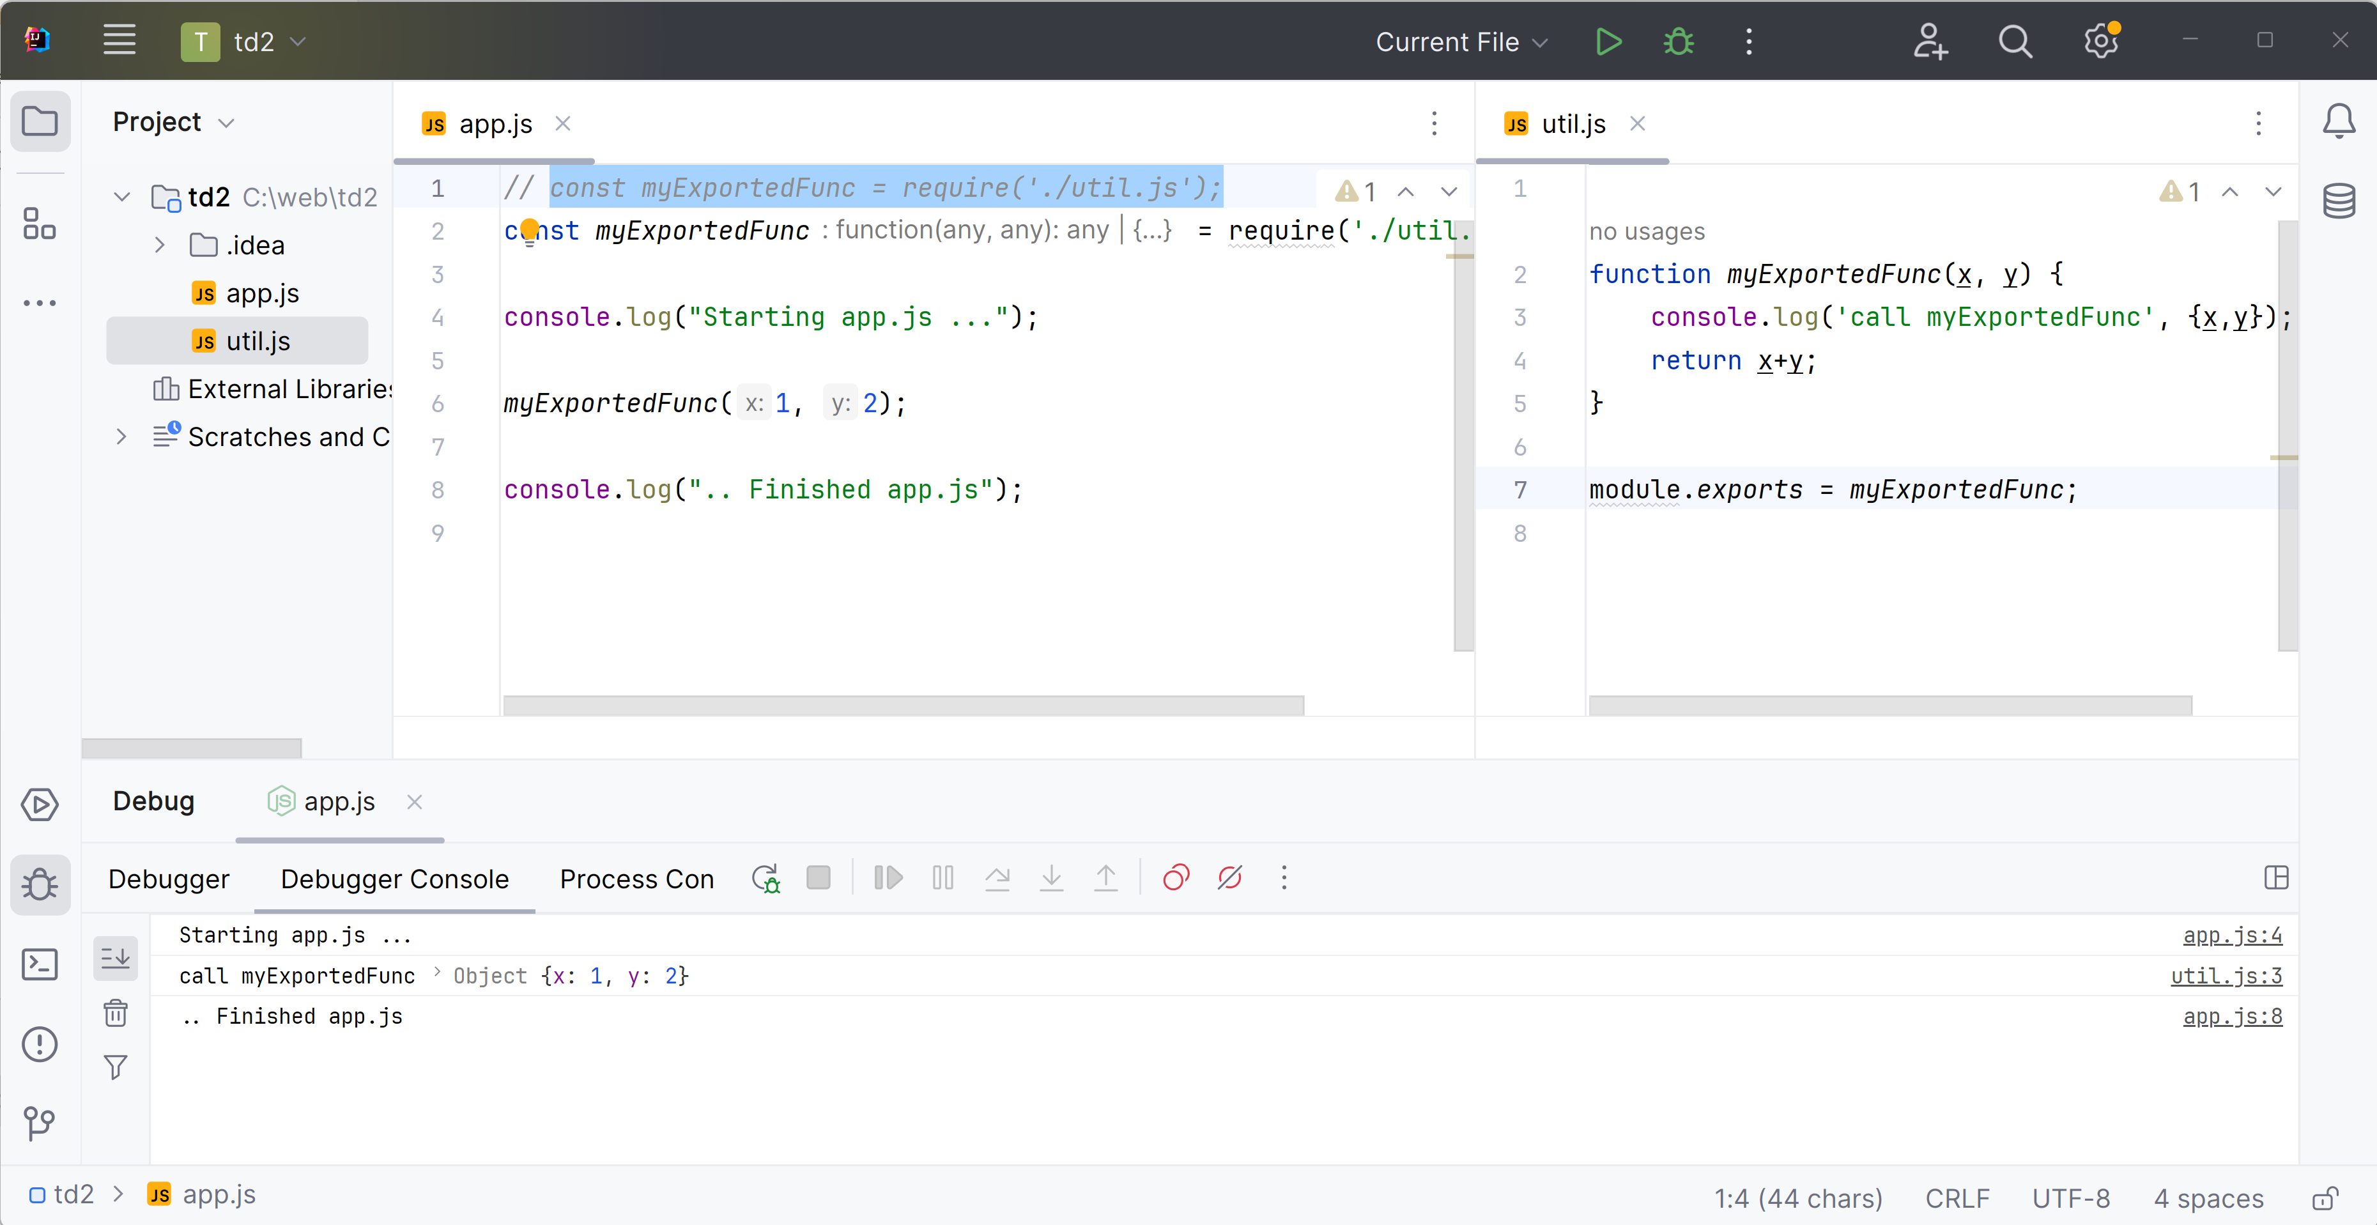
Simplest Answer ... Scenario 1

Slide 26
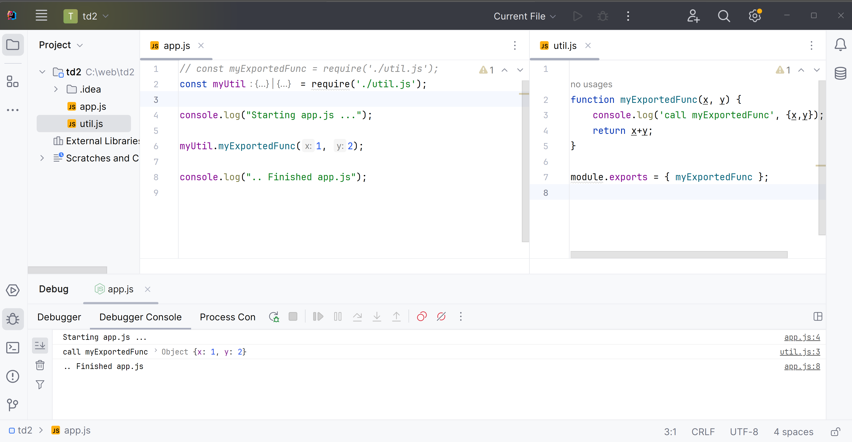
Scenario 2 (export multiple named symbols)
Advanced

Slide 27
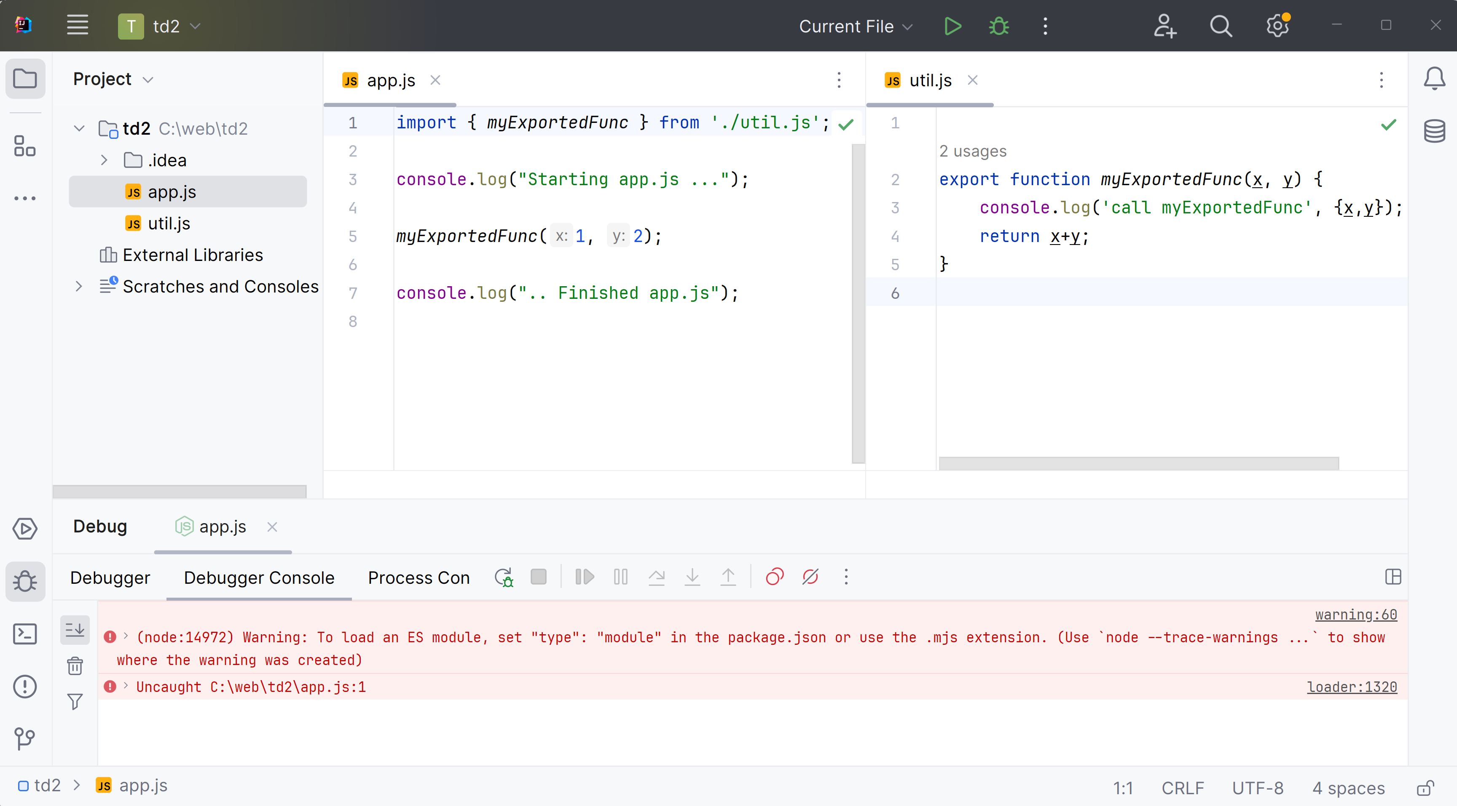
Scenario 3 .. export-import ERROR
Advanced

Slide 28
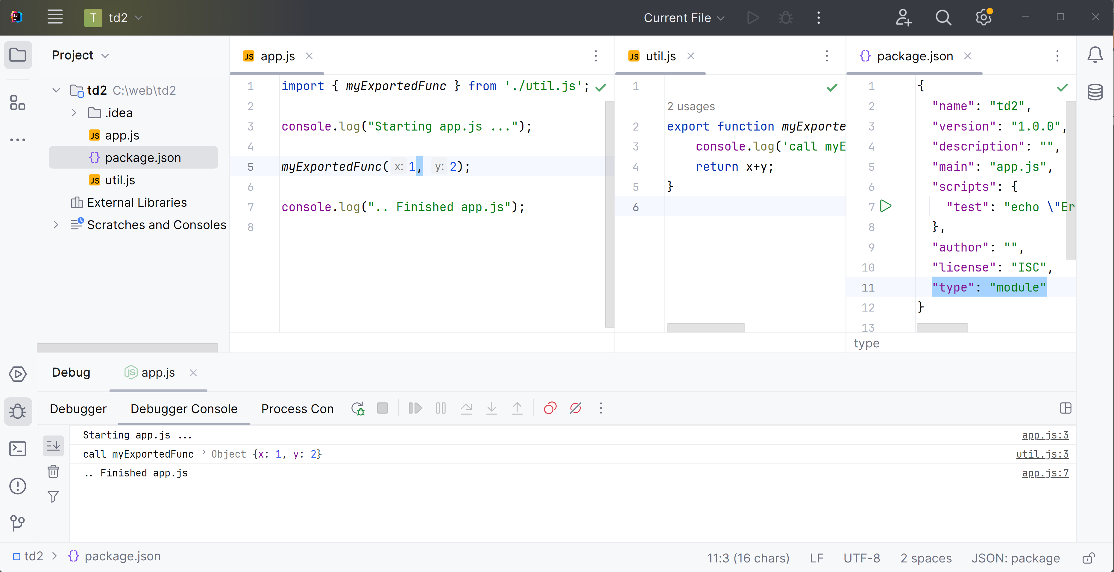
Scenario 4, type:"module"
Advanced

Slide 29
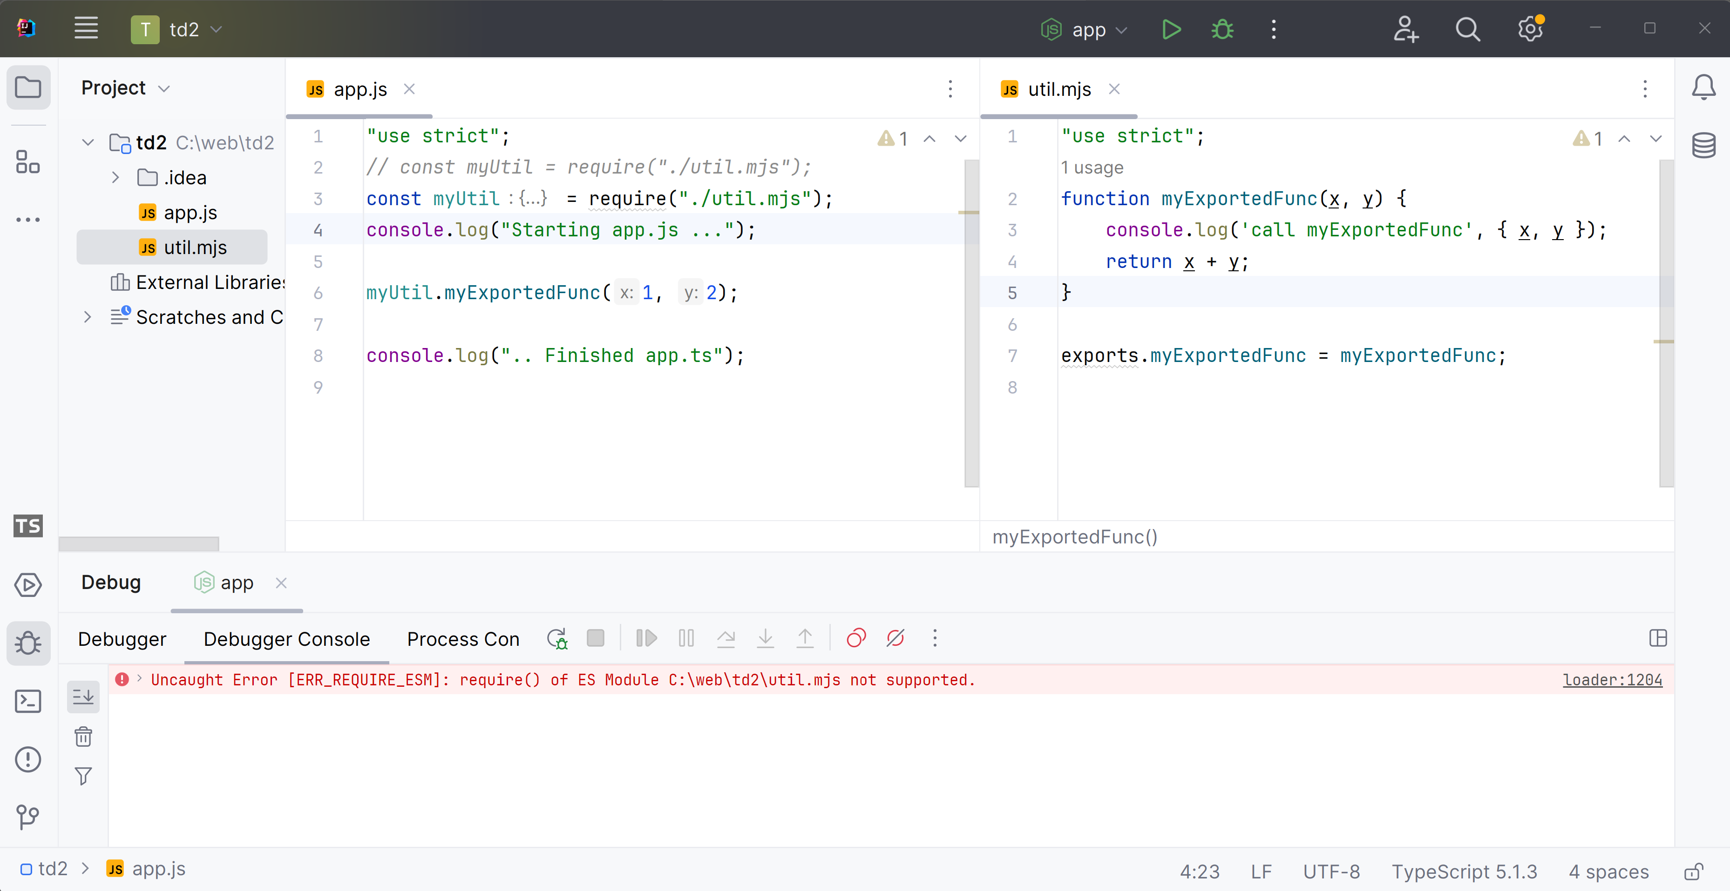
Scenario 5, import file extension ".mjs" ERROR
Advanced

Slide 30
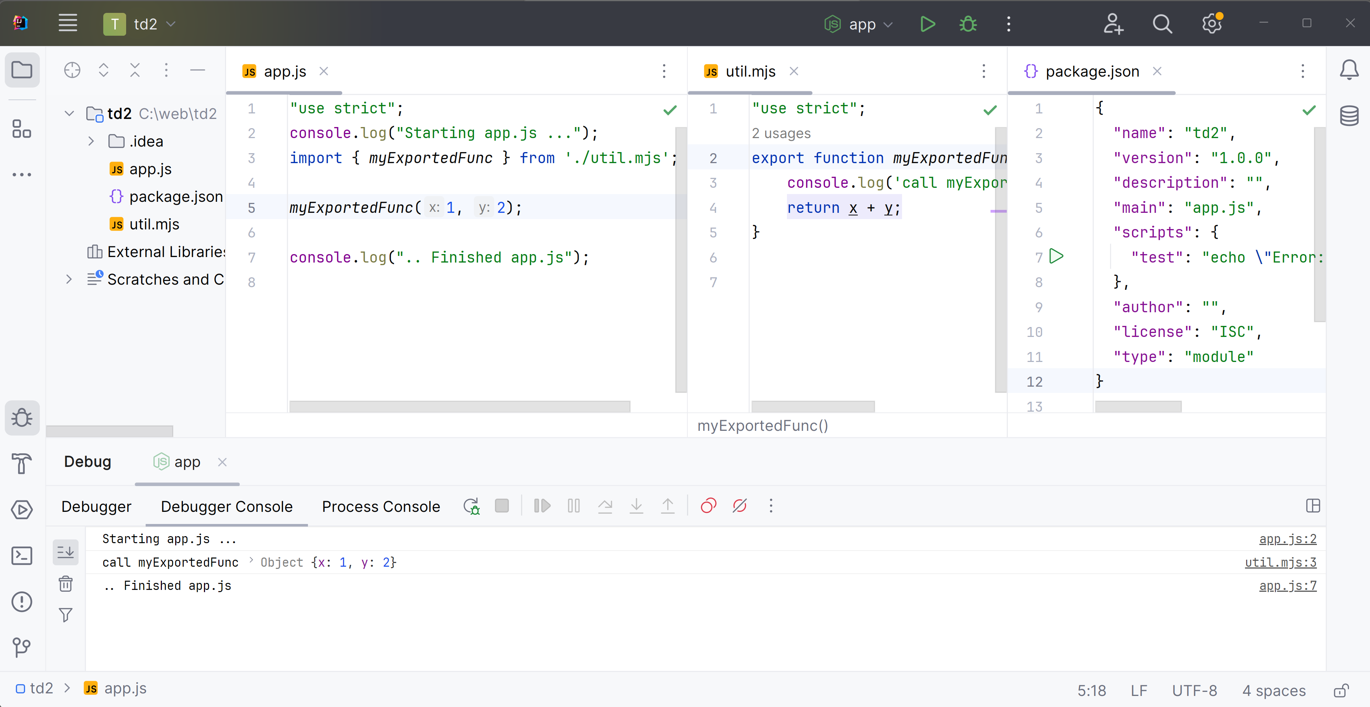
Scenario 6, file ".mjs" + type:module
Advanced

Slide 31
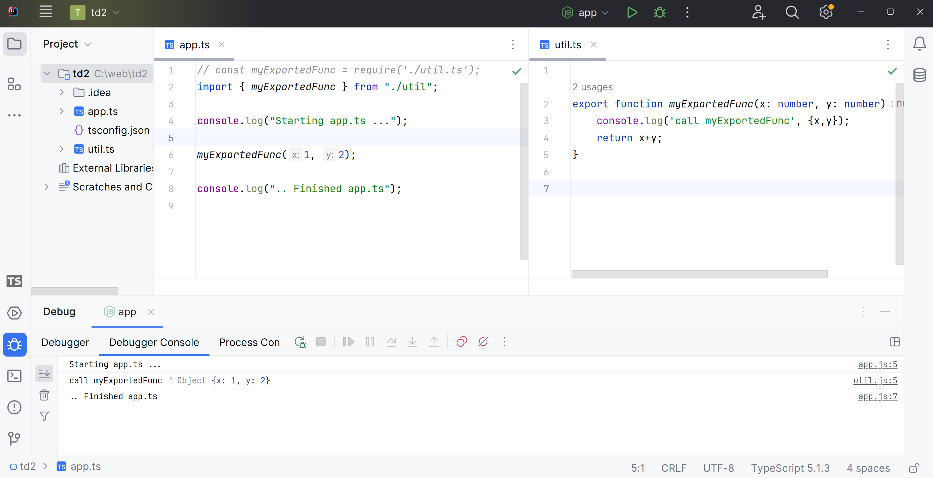
Best Answer - Scenario 7 (TypeScript .. see end of TD)
Advanced

Slide 32
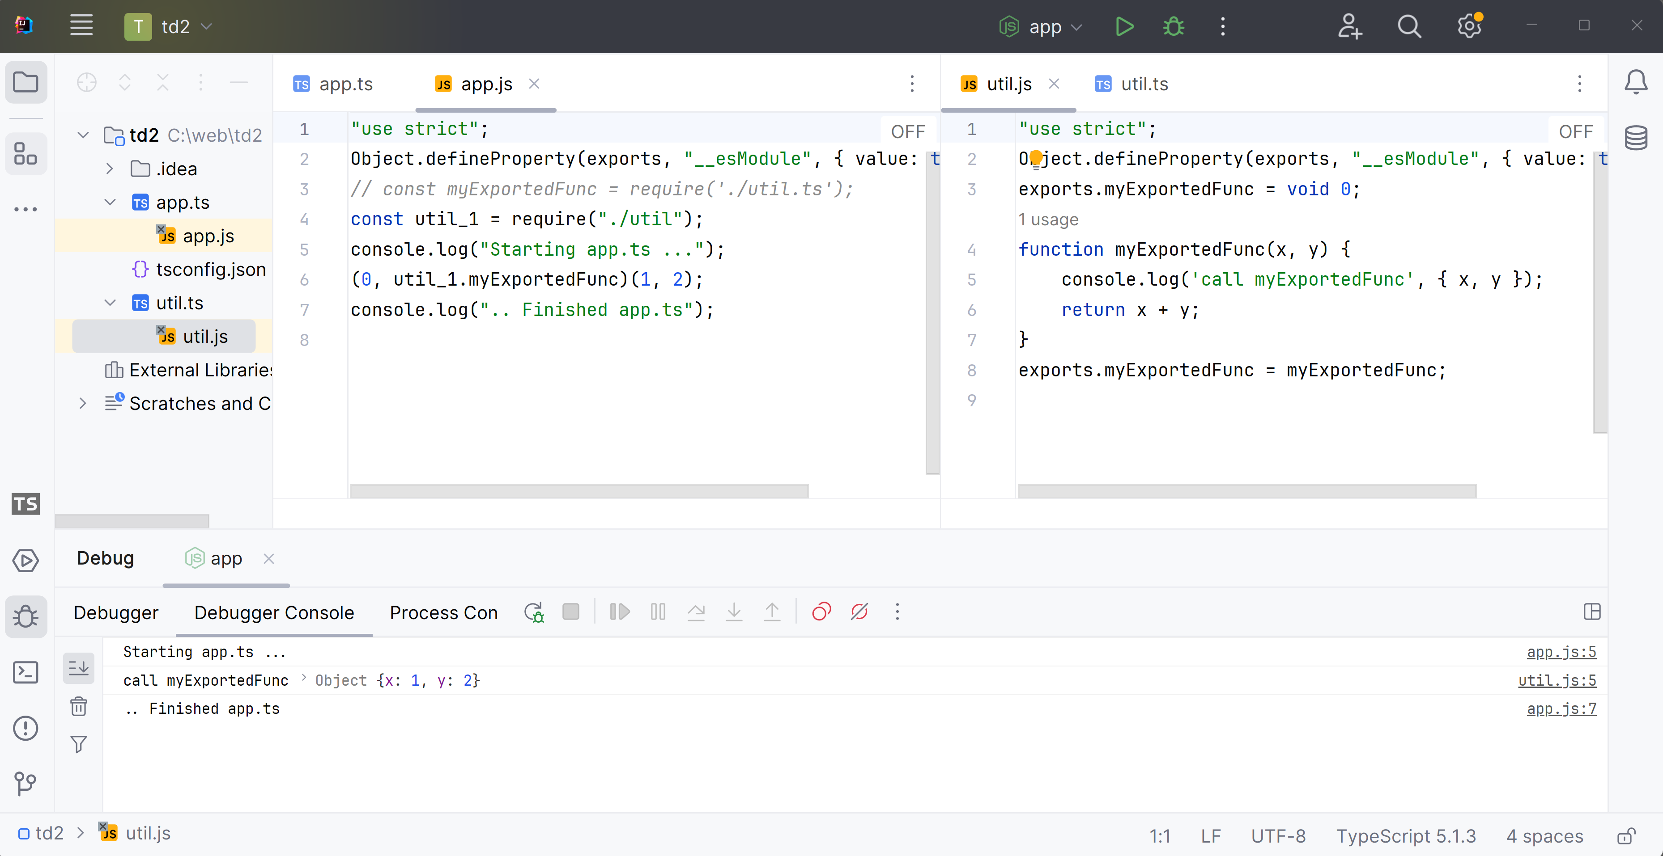
Scenario 7 ... Generated *.js code for *.ts
Advanced

Slide 33
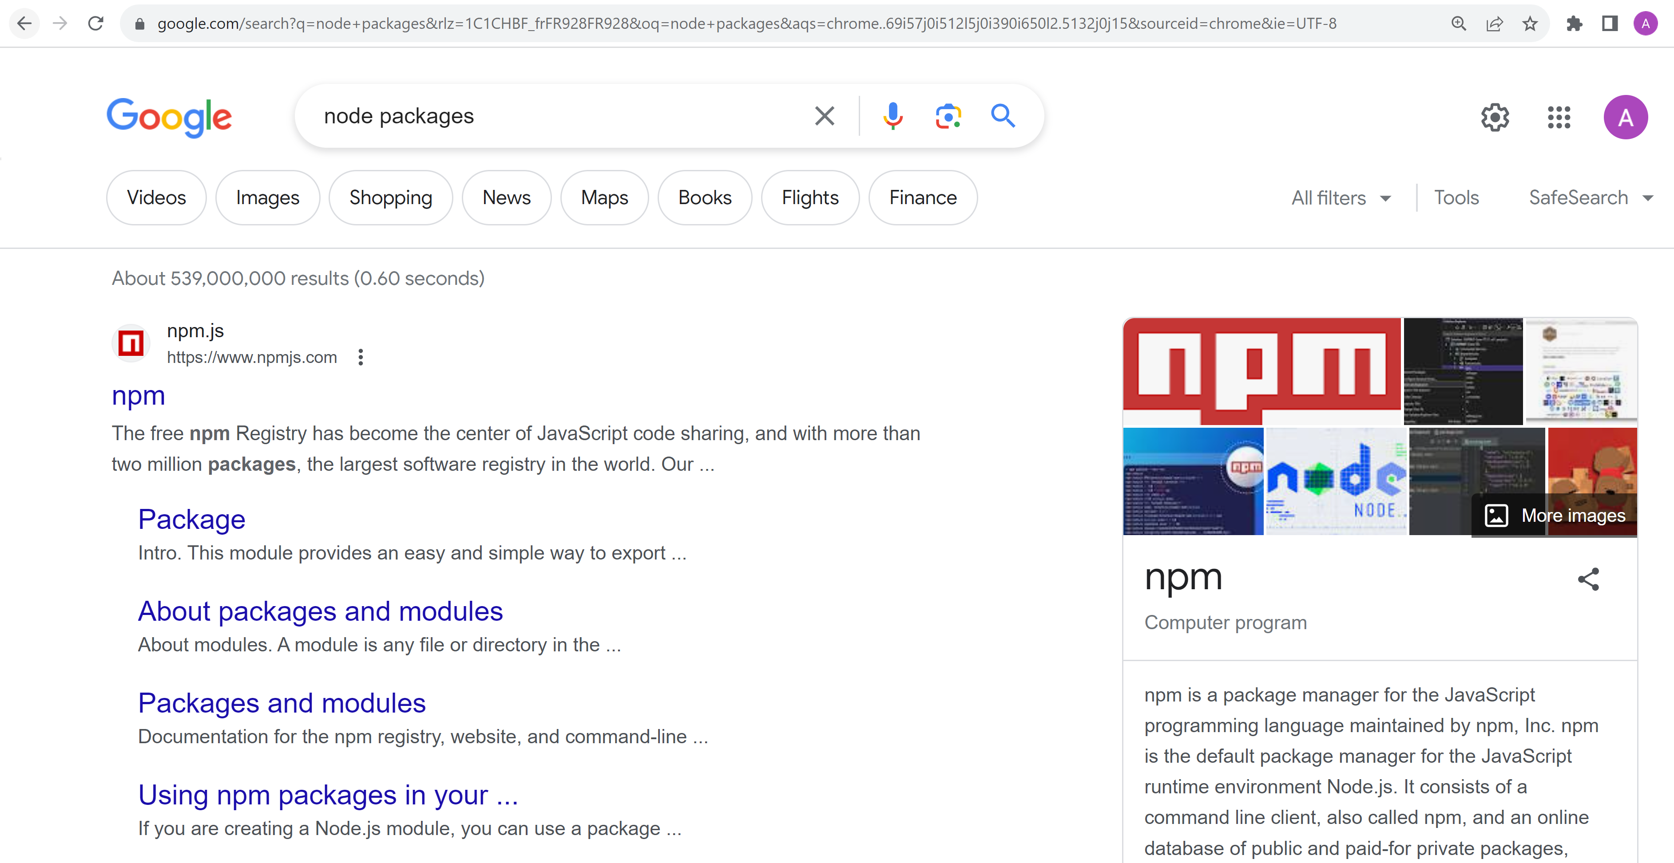
Node … need Package !!! Npm = Node Package Manager

Slide 34
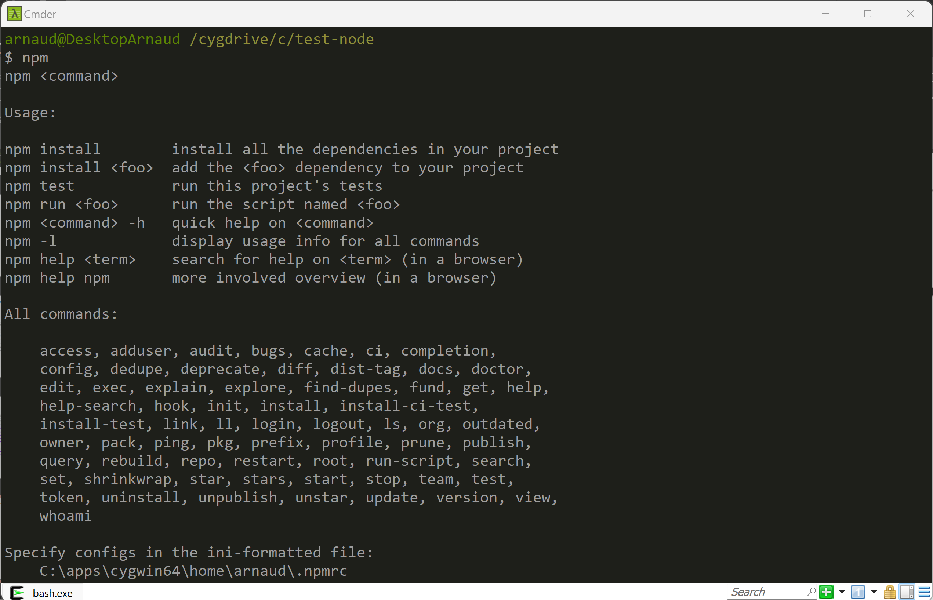
C:> npm

Slide 35
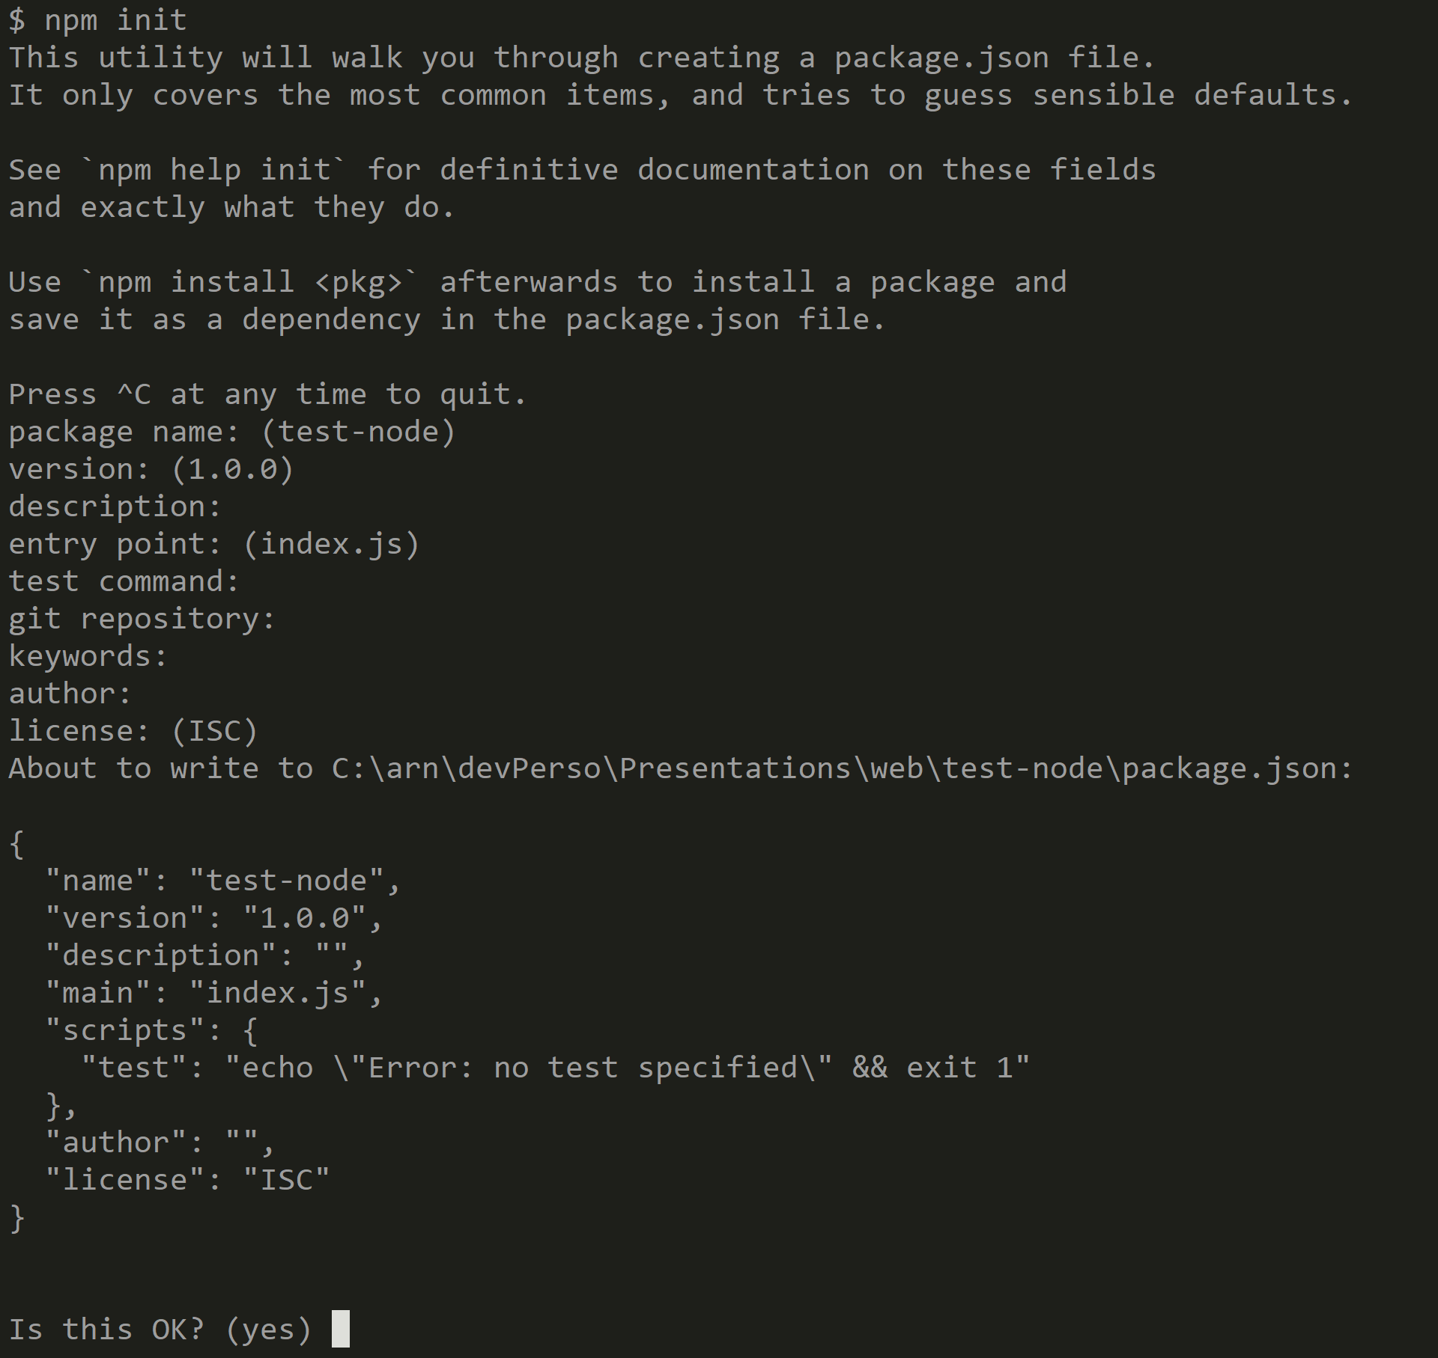
$ npm init

Slide 36
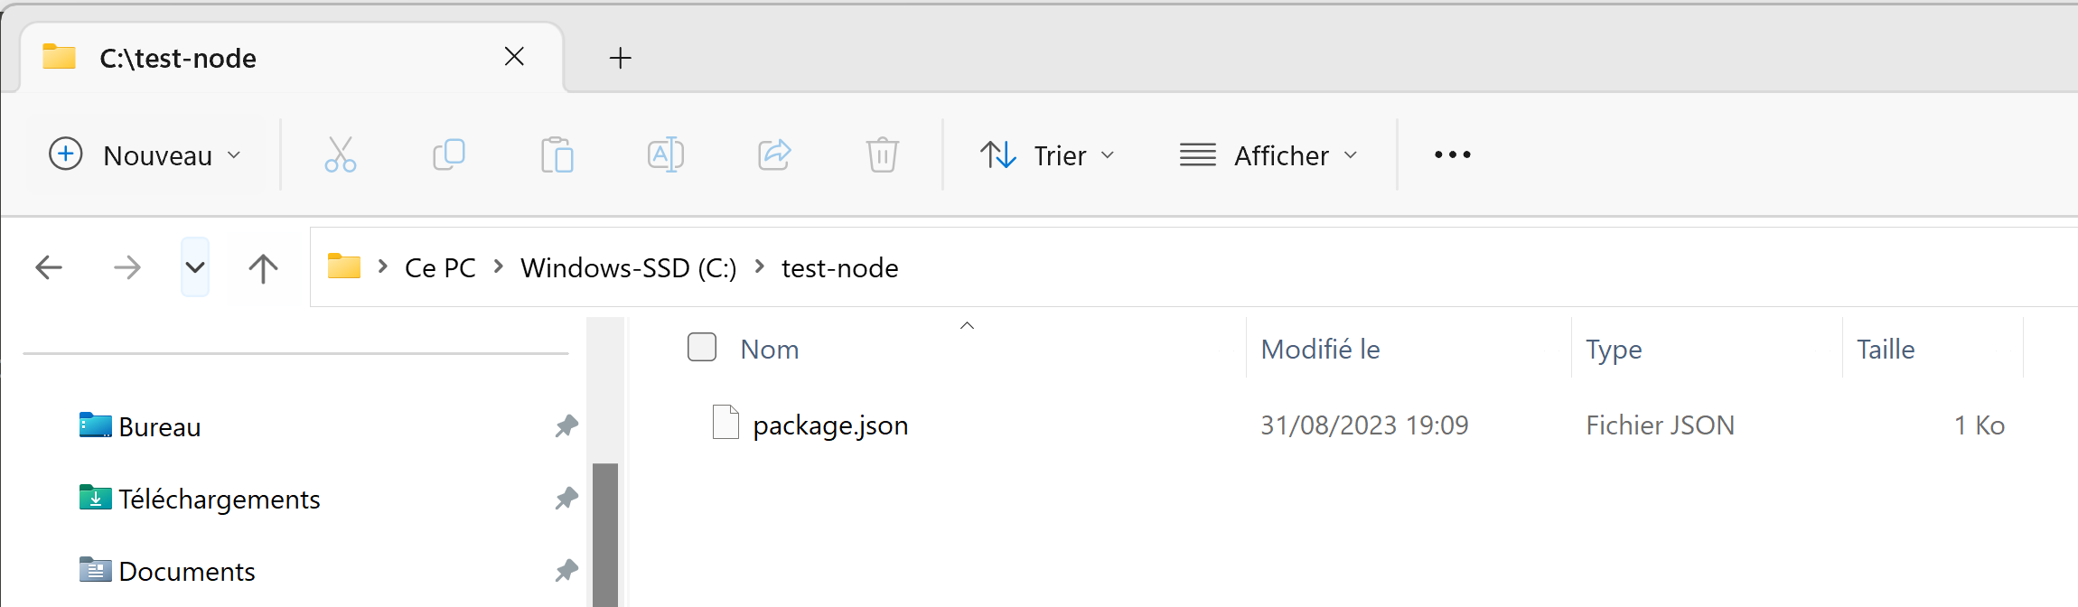
npm init => open File explorer => 1 File « package.json »

Slide 37
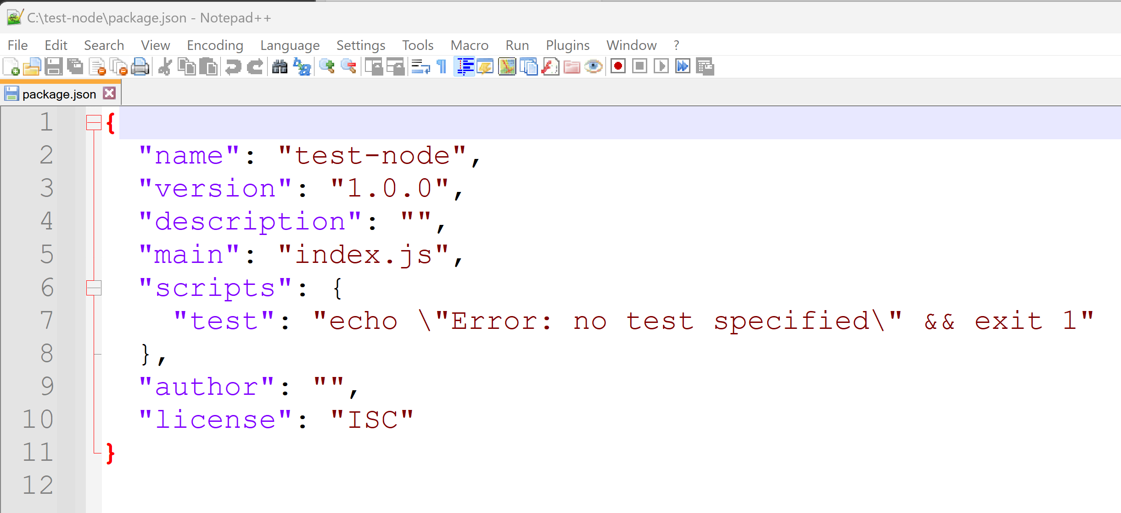
package.json

Slide 38
Search Package dependencies ...

Slide 39
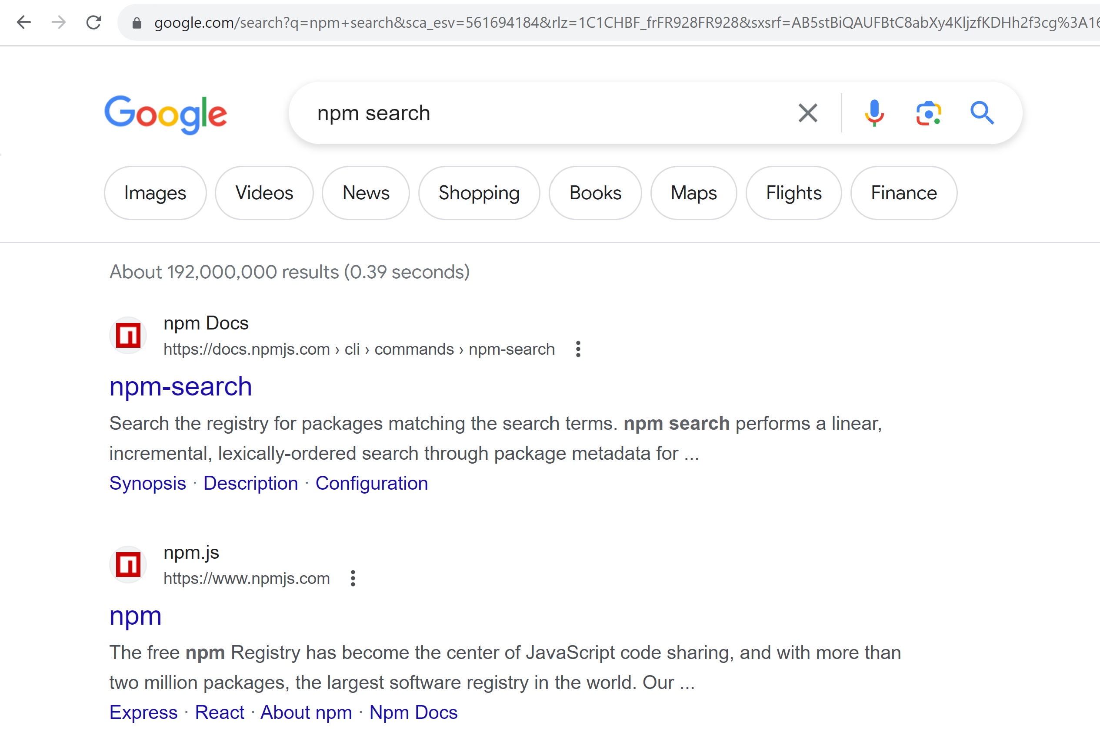
Npm search … Registry (=Repository)

Slide 40
https://npmjs.com

Slide 41
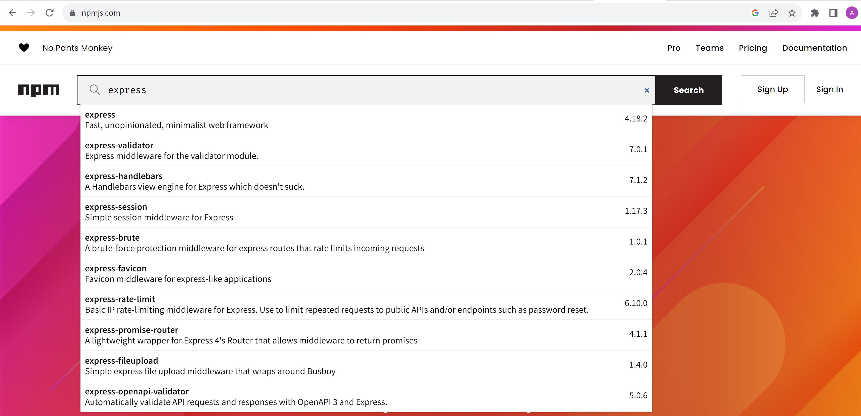
Search « express » package

Slide 42
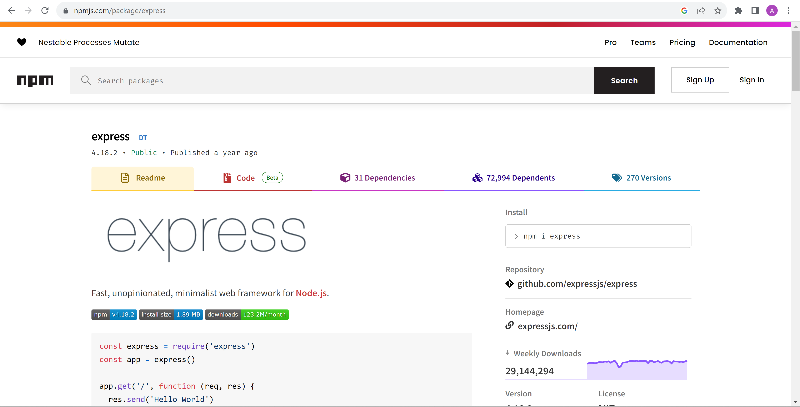
Package express … version / doc / install

Slide 43
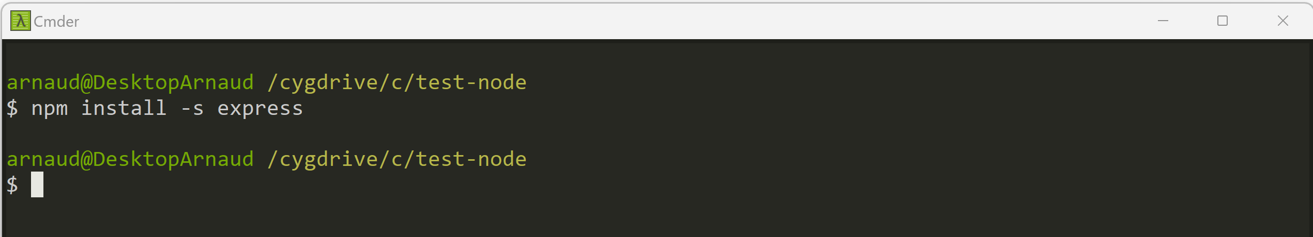
Add npm dependency « express » C:> npm install –s express (equivalent: npm install --save express )

Slide 44
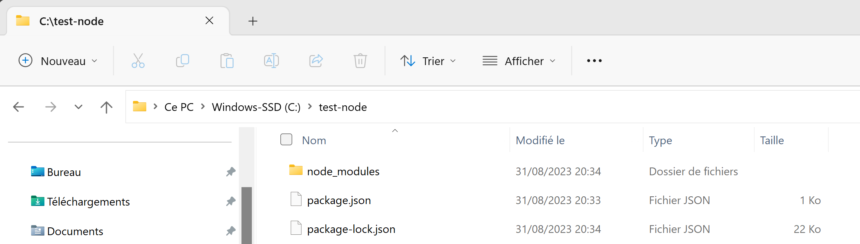
npm --save …. => save to package.json file + package-lock.json + download **/** to node_modules/

Slide 45
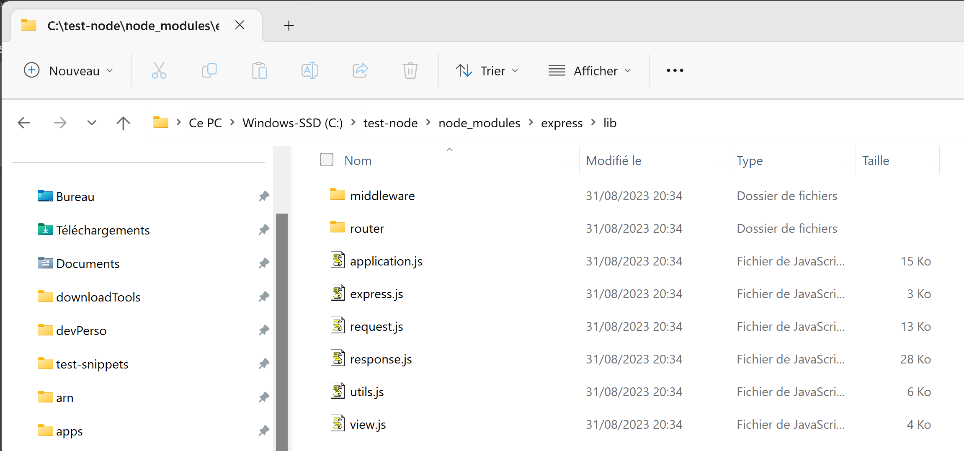
node_modules/express/lib/**/*.js

Slide 46
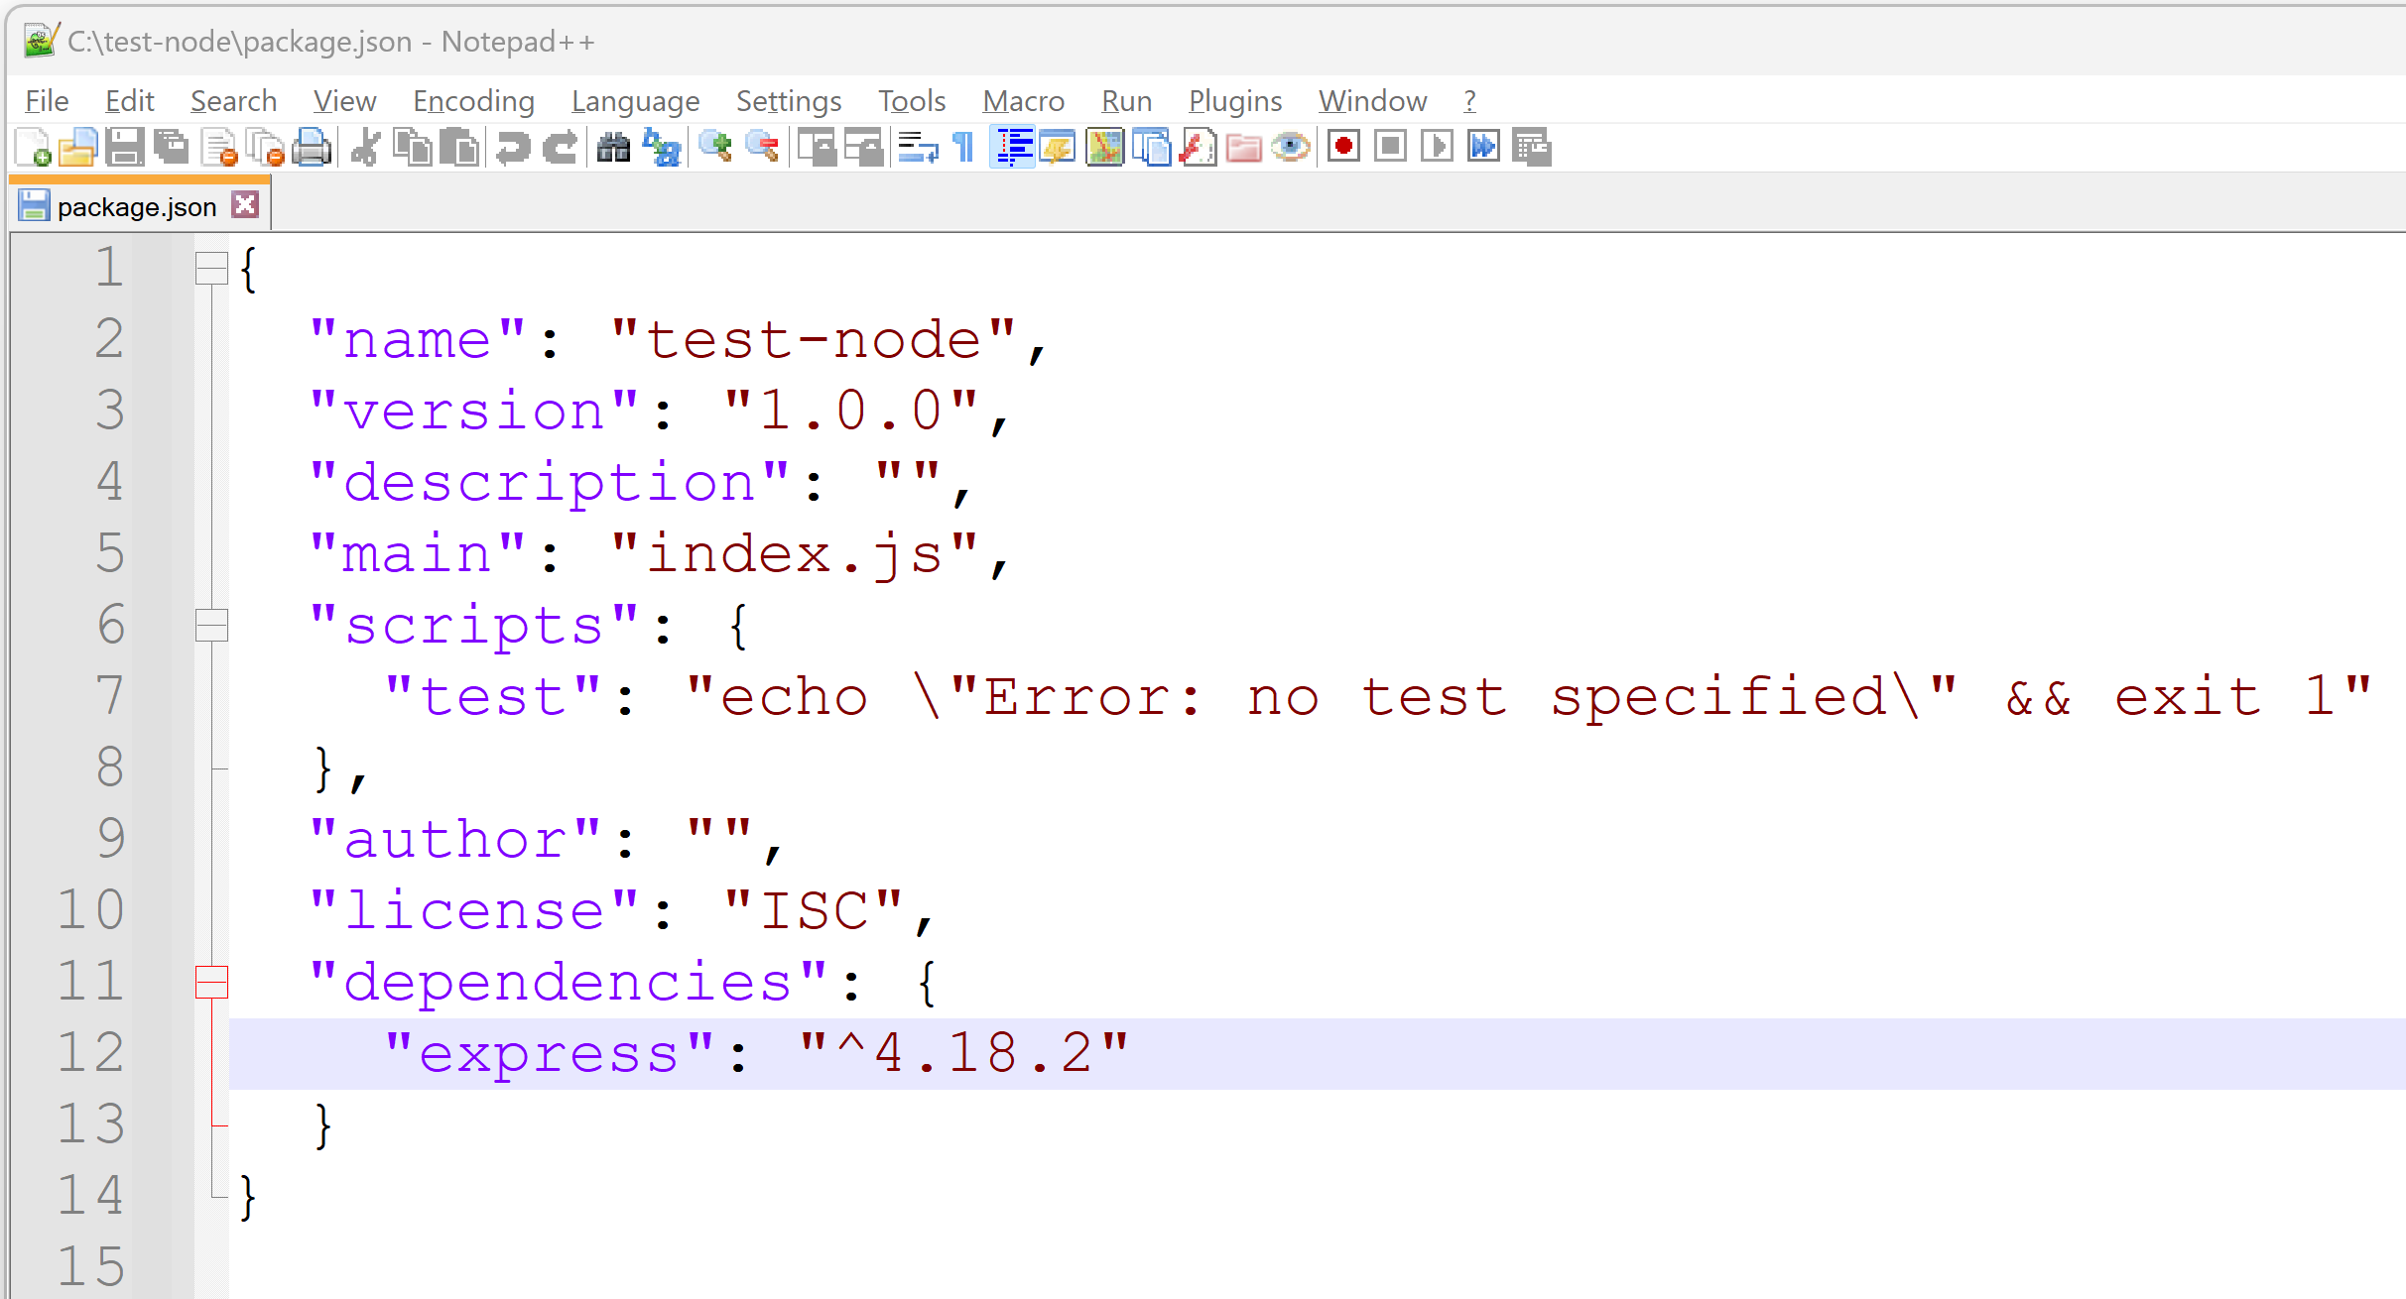
… 1 Line added in package.json dependencies: { «pck-name» : « version », … }

Slide 47
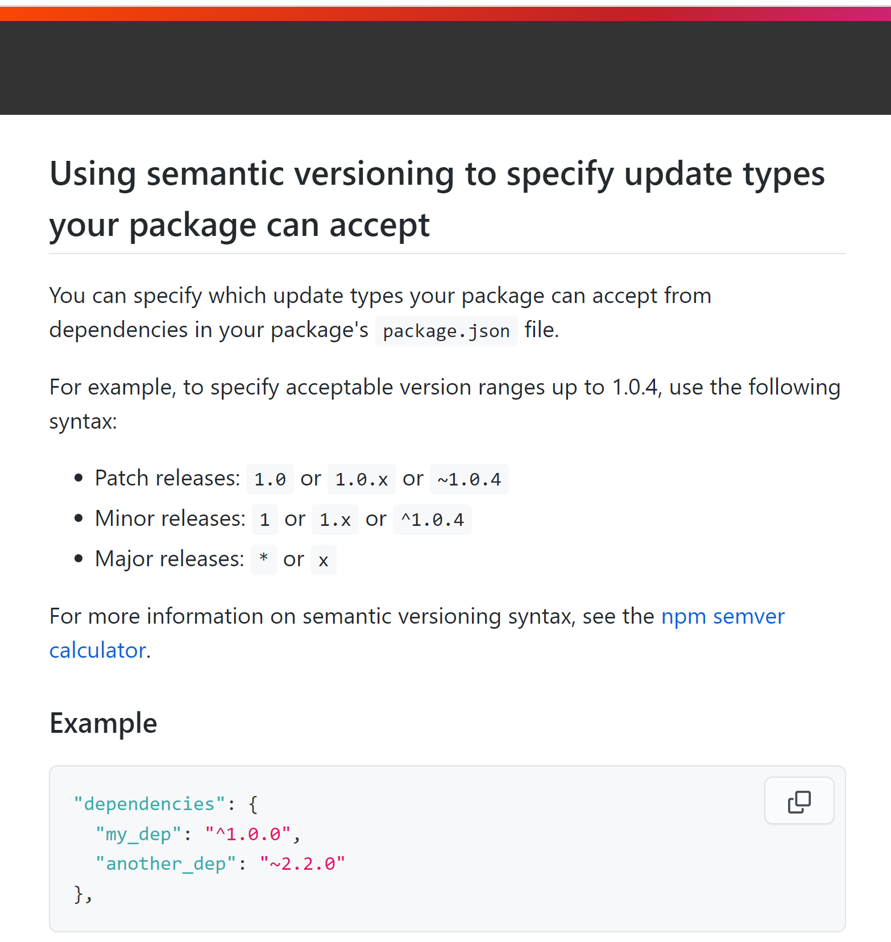
https://docs.npmjs.com/about-semantic-versioning

Slide 48
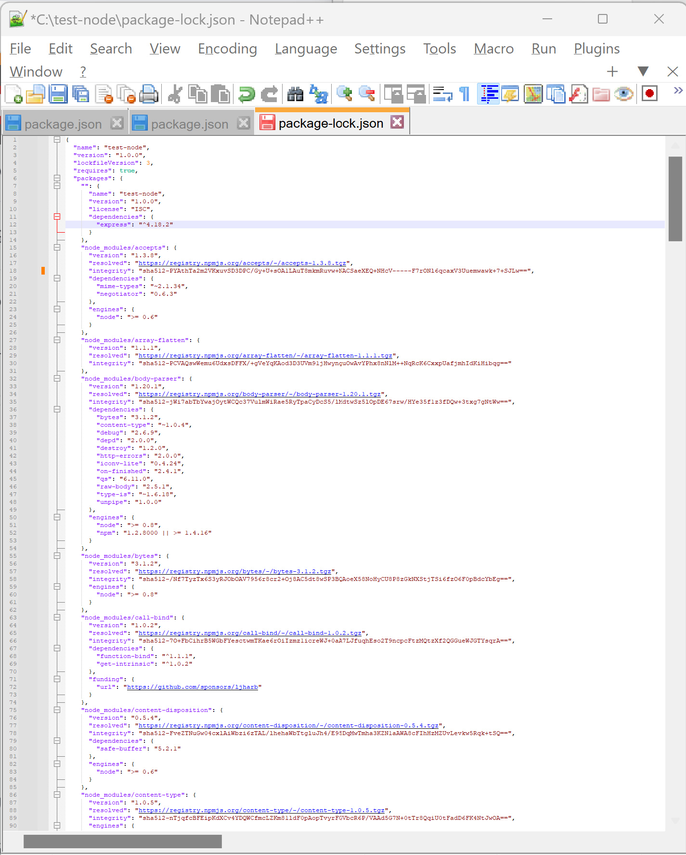
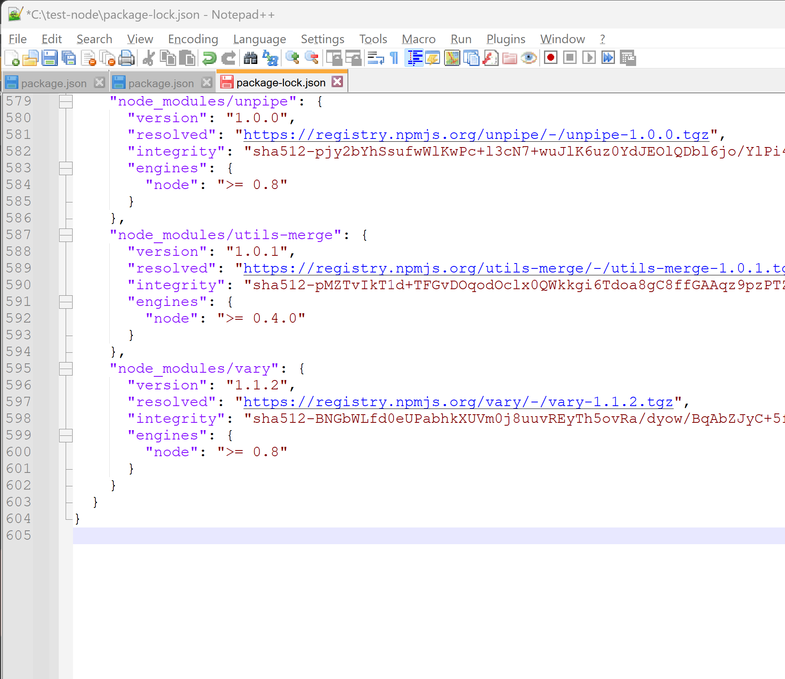
Locking versions number … package-lock.json
File is HUGE …
Like expanded package/package/package !!!
ONLY « express » ➔ 605 lines

Slide 49
node_modules/*/*/*/*.js
Directory node_modules 1/ may be BIG …. ~300 Mega is frequent with few dependencies
$ du -sh node_modules
2/ can be deleted + re-downloaded safely
$ rm –rf node_modules; npm install
3/ should NEVER be committed to any git repository
$ echo node_modules/ >> .gitignore

Slide 50
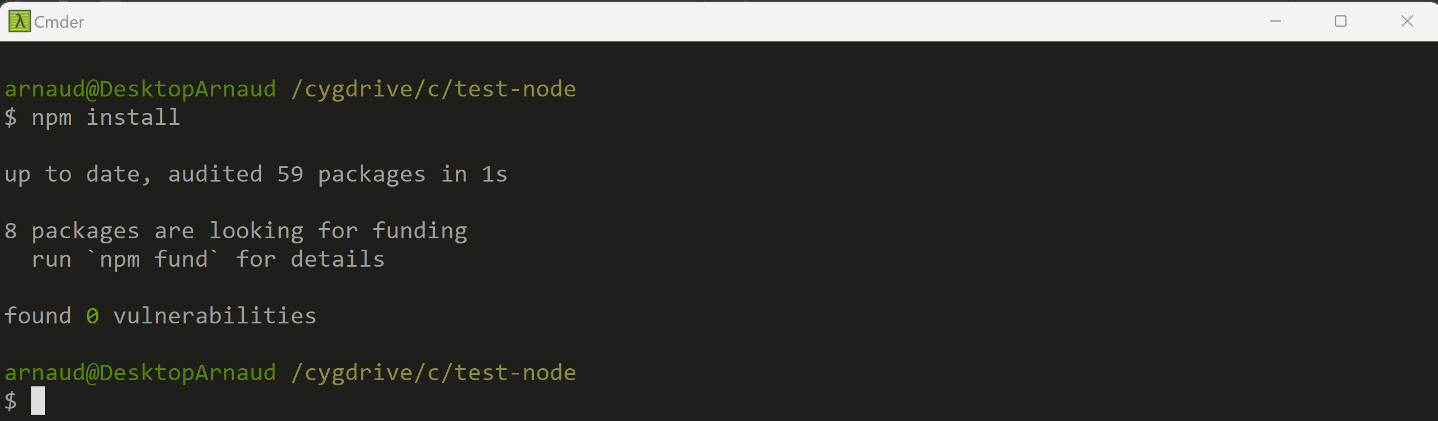
After getting some web project source code… => downloads to re-fill node_modules/** as defined in package.json $ npm install

Slide 51
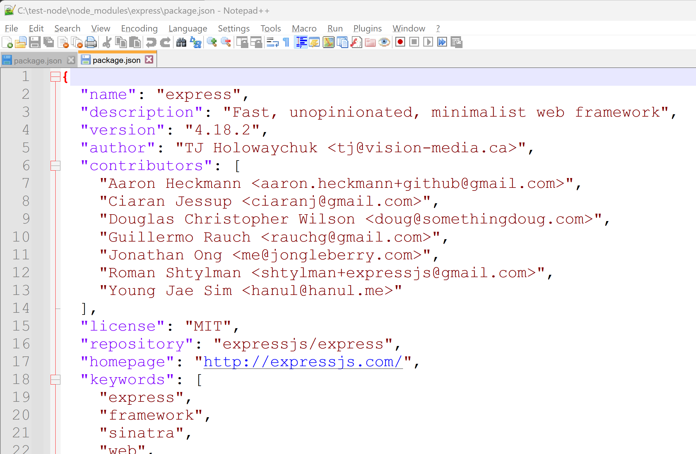
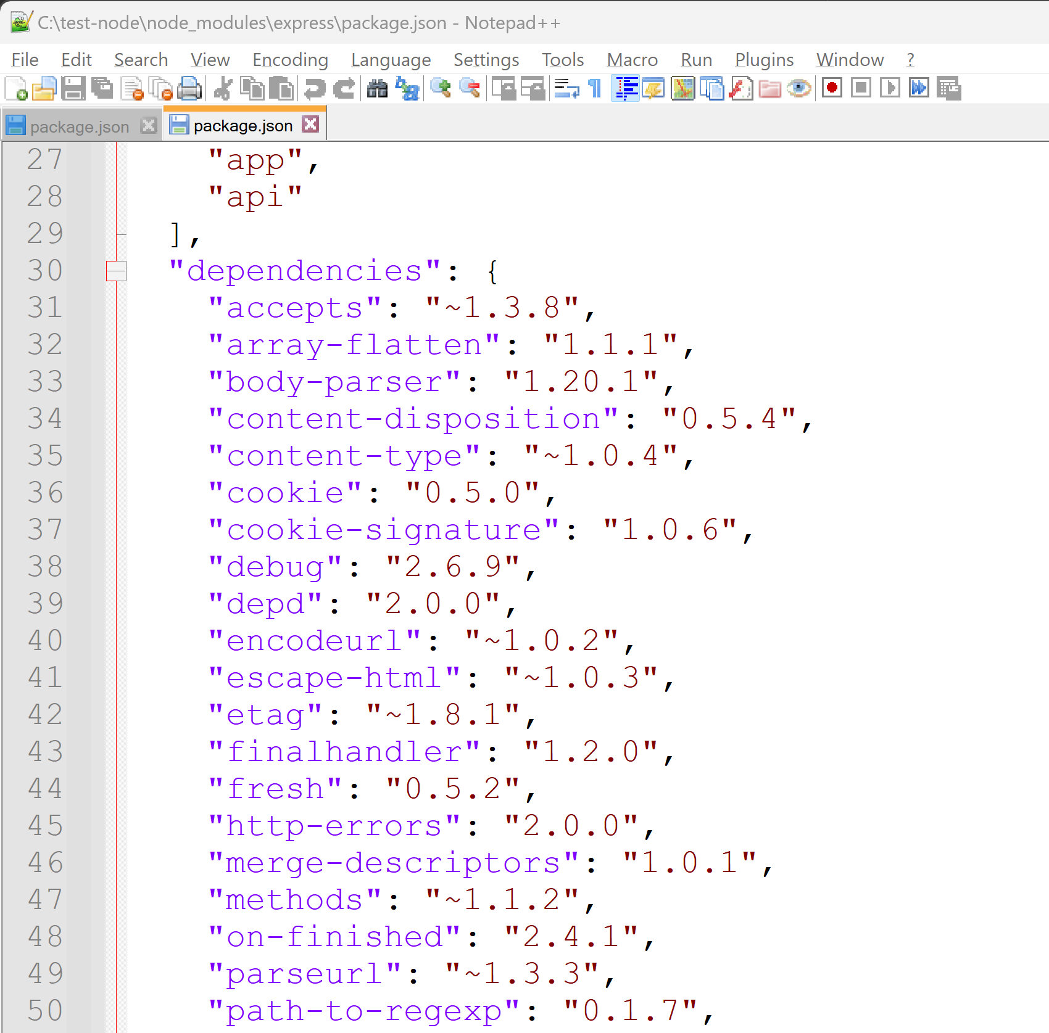
node_modules/express/package.json

Slide 52
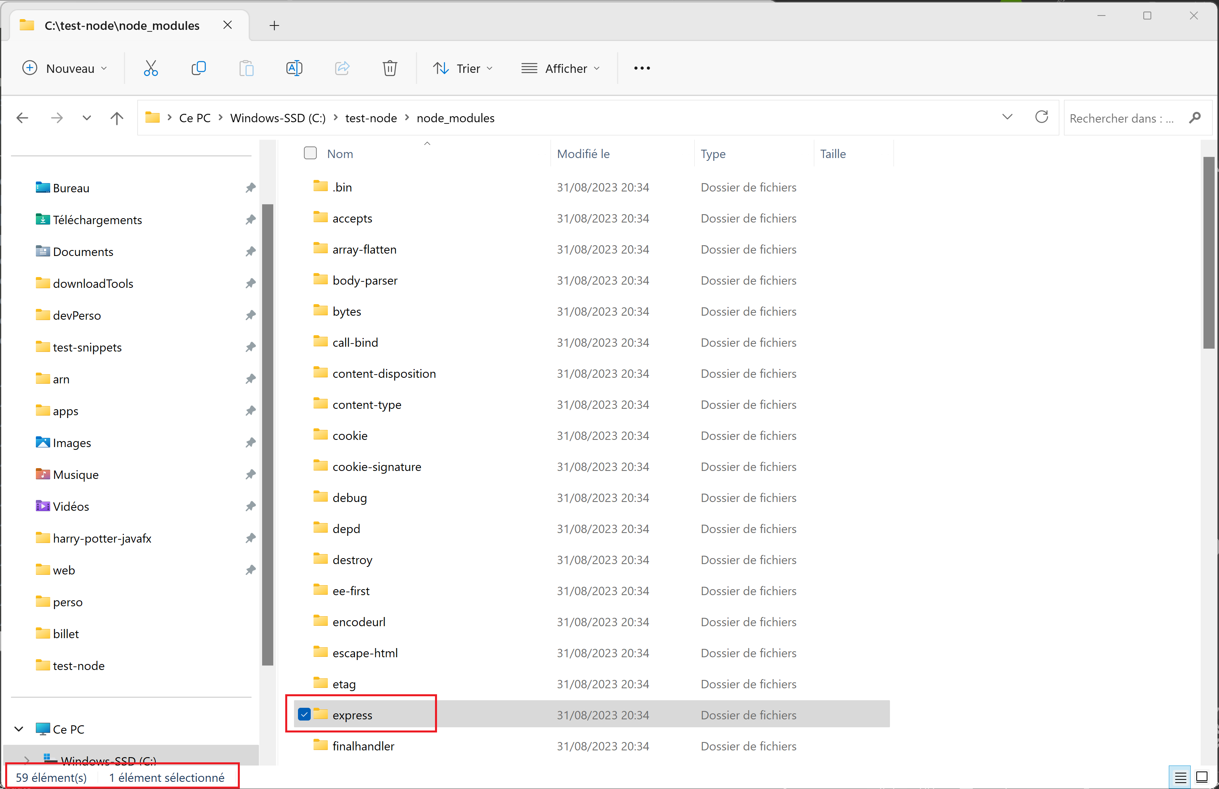
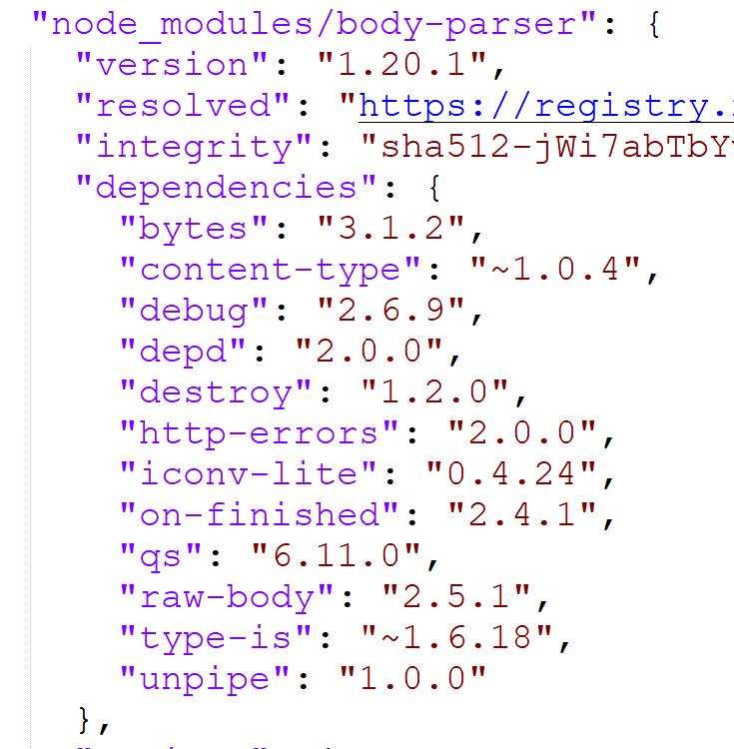
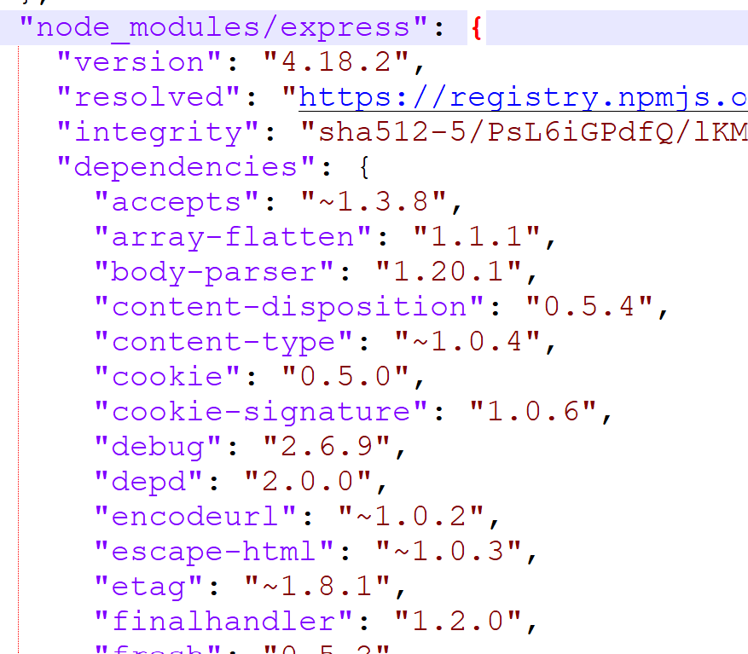
package.json -> package.json -> … package.json transitive dependencies

Slide 53
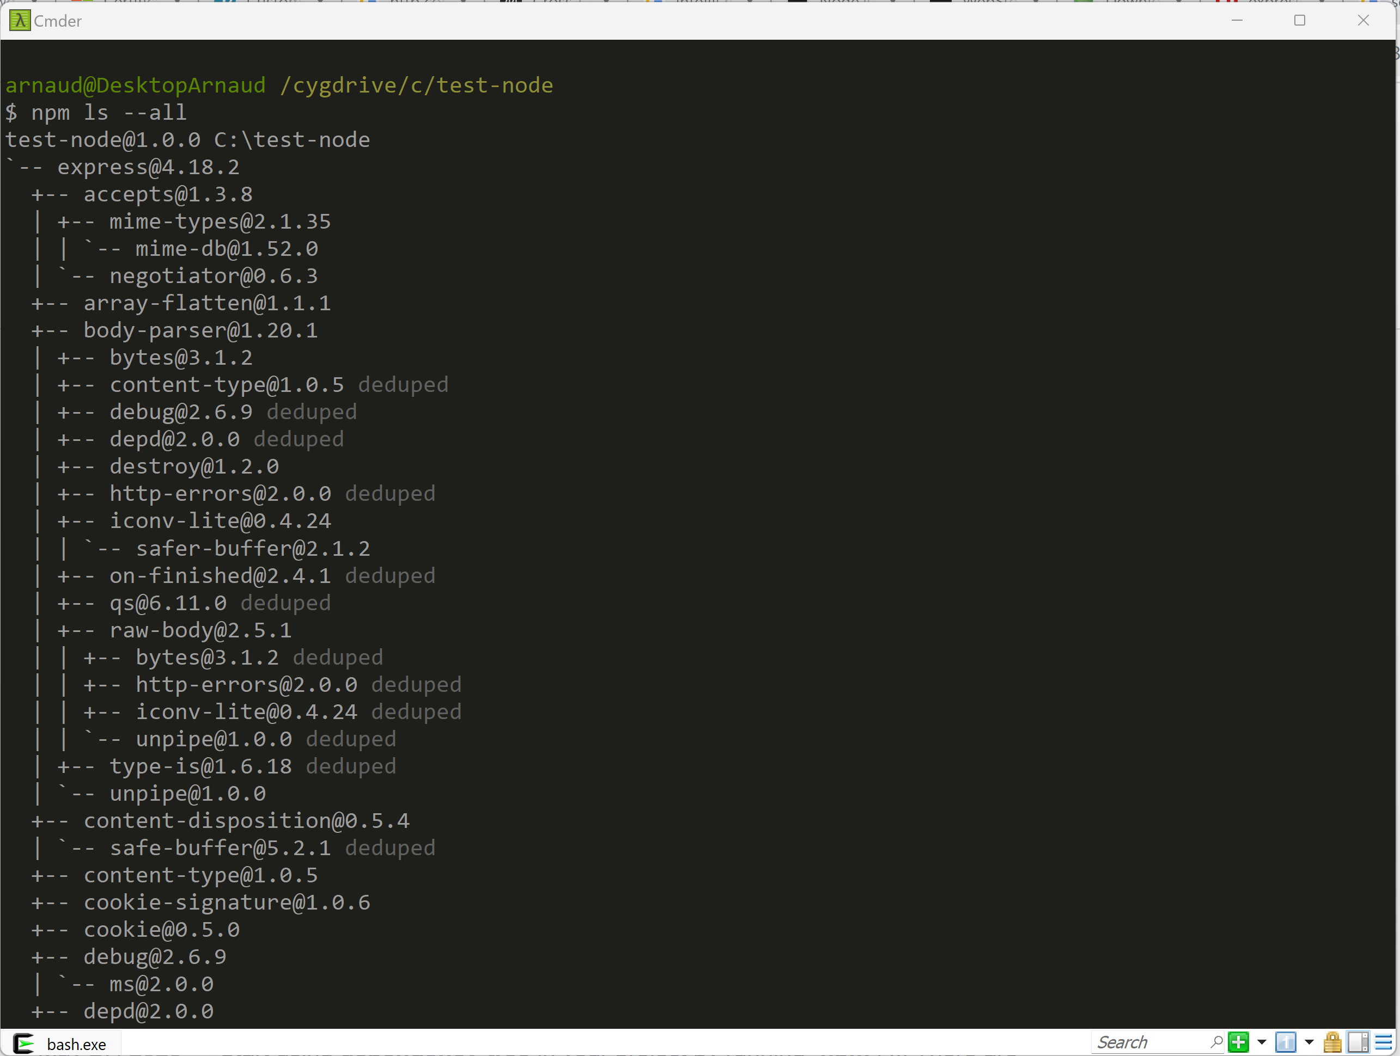
npm ls --all

Slide 54
Coffee break (?)

Slide 55
Choose a Text Editor
IntelliJ Ultimate
Notepad++
WebStorm
SublimeText
Vi
Notepad
VisualStudio Code
Wordpad
Eclipse
NetBeans

Slide 56
Choose (NOT a Text Editor) a modern IDE
IntelliJ Ultimate
Free for students
(register with esilv email) else €€ or 30 days eval
WebStorm
VisualStudio Code
Eclipse + plugins
Eclipse(plugins not pre-installed)
IntelliJ (No web js Support)

Slide 57
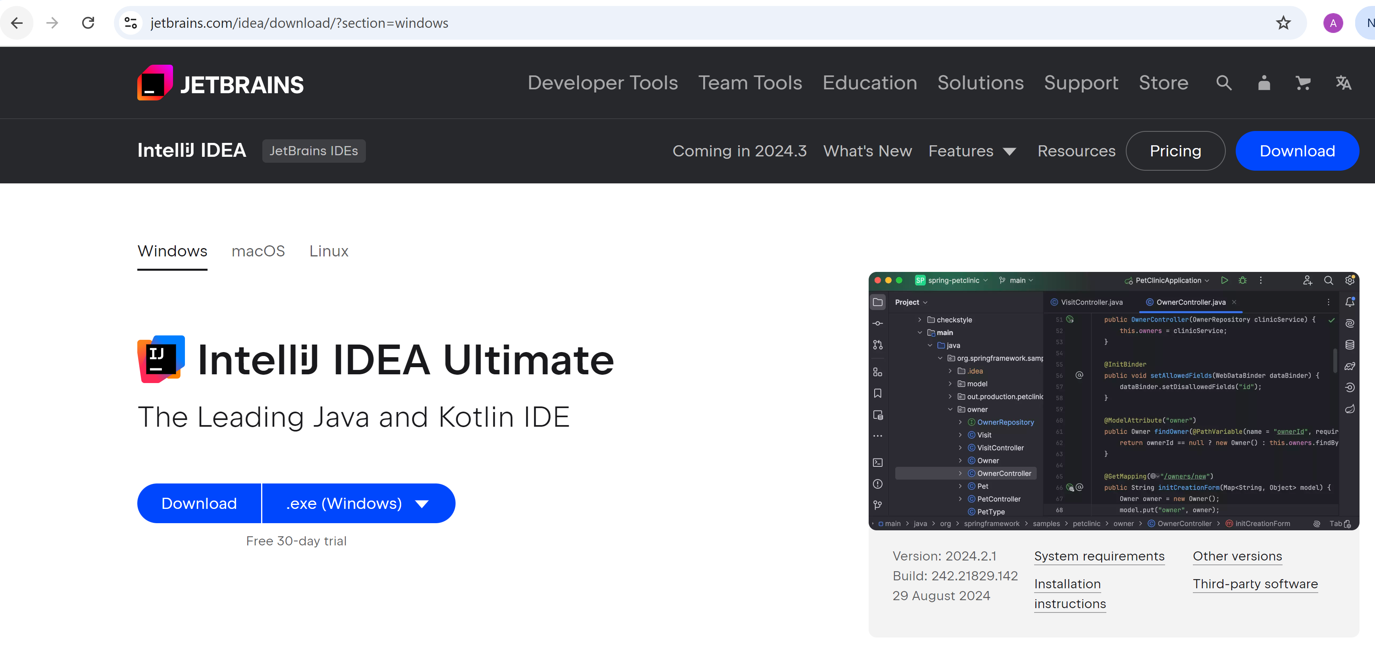
https://www.jetbrains.com/idea/download

Slide 58

Pricing > Special Categories > Students

Slide 59
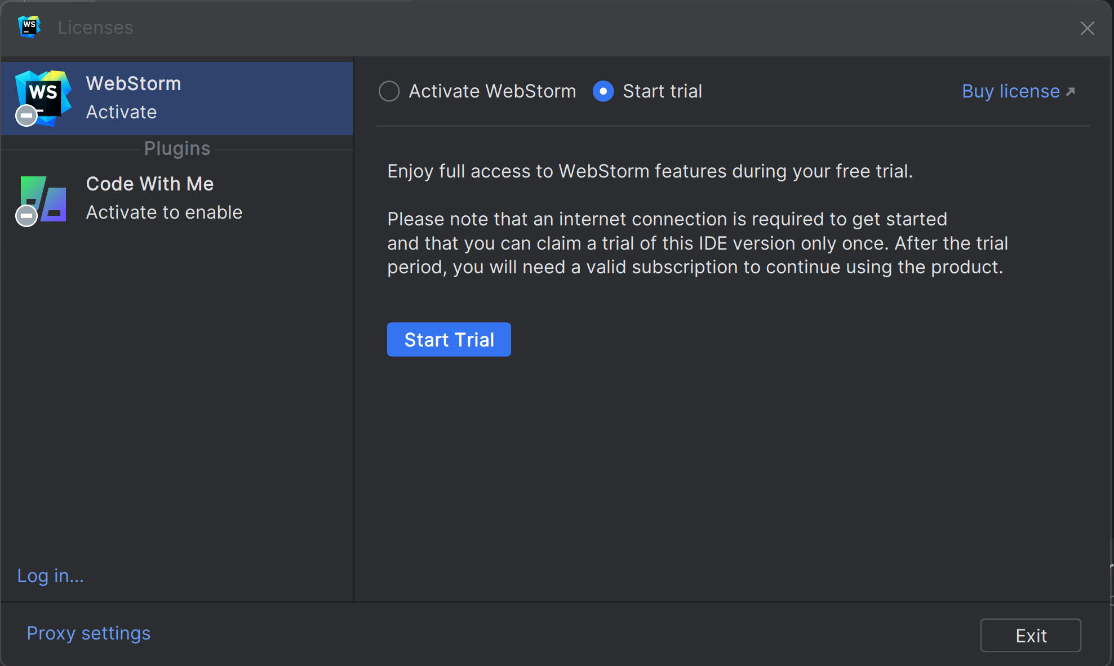
Notice Licenses: IntelliJ Ultimate = WebStorm + IntelliJ + …. IntelliJ Community = Java only .. NO web ! WebStorm = Web Only .. !
click on "Buy License" .... then fill esilv email
else click on "Start Trial" (30 days)

Slide 60
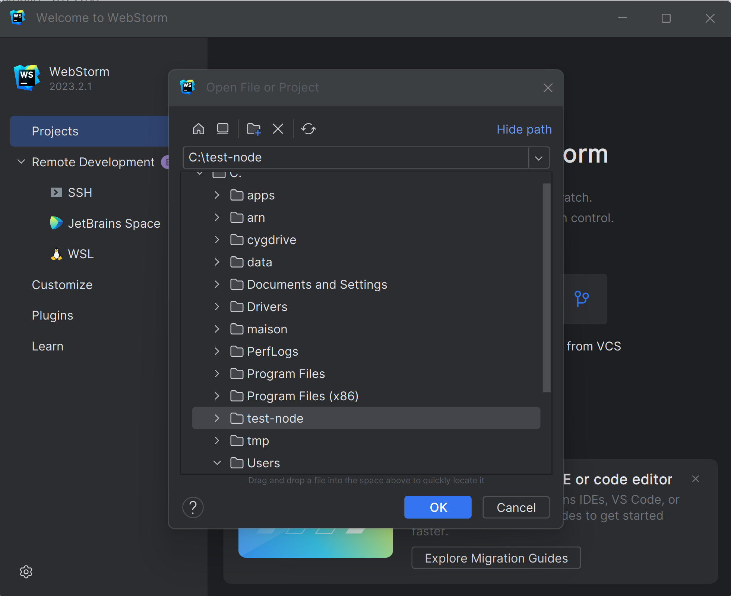
Open Project

Slide 61

Edit program.js File

Slide 62


Click on « Run » or « Debug » ?
Debug Mode …. Find the « bug »
Can put breakpoints !
Run Mode ….
Start and forget
Can NOT activate any breakpoint
… can only see logs, and Kill
Why do you use an IDE Debugger
Use directly « C:> node » ??

Slide 63

… Case undetected « node » not in %PATH%
System Diagnostic

Slide 64

Configure … Add node
System Diagnostic

Slide 65

Edit Run/Debug configuration…
System Diagnostic

Slide 66

« Run » … Program Finished + console print

Slide 67


Redo « Run » or « Debug » Need to re-edit node in %PATH% ???
System Diagnostic
At least, can re-select
already added choice « C:\... » !

Slide 68


Change configuration « your-config » instead of « Current File »
System Diagnostic

Slide 69

Debug « Mode » + Breakpoint => Program Paused

Slide 70

Step Into(F7) < Step Over(F8) < Step Out (Maj F8) < Resume (F9)

Slide 71
Coffee Break

Slide 72

Complains on JavaScript ?
for Christmas Wish List, ask
Types declarations (standard types, structural types, union types)
Compiled-time Type checking
With Implicit types inference
Object-Oriented Classes
Templates
Spread operators
Syntacic sugars
..

Slide 73




TypeScript

Slide 74

Edit a TypeScript *.ts File

Slide 75

Right Click « Compile TypeScript »

Slide 76

Open Item « .ts » > Sub Item « .js » see generated Js !!

Slide 77

Debug Ts program … (No Run/Debug/breakpoint in *.ts, but ok in *.js) need « .map » file for mapping ts line X <-> js line Y

Slide 78

Edit Settings > TypeScript > Recompile on changes

Slide 79

Edit on Left *.ts … see real time change in right *.js

Slide 80



Edit many **/*.ts … see corresponding **/*.js
Expand views
Check on FileSystem

Slide 81
tsc = TypeScript Compiler … same as in IDE, but in batch mode, for CI-CD
tsc is internally used by WebStorm
… / IntelliJ / VisualStudio Code / Eclipse !!
tsc even generalised it as « langage server »
=> You have exact same compilation in all IDEs !!

Slide 82

https://www.typescriptlang.org/docs/handbook/typescript-tooling-in-5-minutes.html

Slide 83

$ npm install –g typescript ( « -g » for « --global » … add tsc in node %PATH%)

Slide 84

$ tsc

Slide 85
3 uses cases … 1/ compile 1 single .ts file 2/ compile **/*.ts in project 3/ « -w » real-time watch to recompile on change

Slide 86

$ tsc single-file.ts

Slide 87

Tsc Compiles … find ERRORs messages at compile-time Compare… remember typo found at runtime ? https://my-broken-web-site-deployed-in-PROD.html

Slide 88

Setup a Typescript project $ tsc -init

Slide 89

Alternative option ONLY in WebStorm to create « tsconfig.json »

Slide 90

Default tsconfig.json

Slide 91

Notice sourceMap:true in tsconfig.json … and **/*.js.map files generated

Slide 92

.map file … = « lineNumber » debugging info between source « *.ts » and generated « *.js » Analogy with java: between source « *.java » and generated « *.class »

Slide 93
Remark and Analogy
JavaScript is the « low-level » assembler langage (~x64) on the Web
Supported by all « web browsers » AND « node » (~intel/amd processors)
No developper code anymore in assembly langage directly
(they prefer high-level C, C++, Java, C#, Python, …)
Web developper prefers TypeScript rather than Js directly ..

Slide 94
Remark of The Remark … WebAssembly
JavaScript is such an horrible monster langage
(with eval and strange permissive things)
W3c standard « WebAssembly » use only a SUBSET of JS
… that can be really statically typed / analysed / understood
then transformed to native x64 code by « compiler »
« WebAssembly » is trully a fast assembly langage
almost as fast as optimised « normal » code

Slide 95

.map Goodies … can put breakpoint on *.ts (still debugging *.js for launch)

Slide 96

$ tsc ( or equivalent : $ tsc –p tsconfig.json )
Case when error…
Case when OK…
NO log !!

Slide 97

$ tsc -w
Case when OK…
NO log
Case when error… cf next slide

Slide 98


Edit file to get Compile Error with –w (watch)

Slide 99

Install « typescript » in package.json devDependencies (devDependencies != dependencies, != global ) $ npm install –save-dev typescript

Slide 100

devDependencies…

Slide 101


Edit package.json « scripts »
« $ npm run compile-typescript »
… is equivalent to « $ tsc »
« $ npm run build »
… is equivalent to « $ tsc -w »
Notice:
There are Run icons for each script line

Slide 102
Understanding Angular « ng » client internals
« npm run start»
Internally Call
Internally Call
« ng serve »
« tsc -w»
Compile all *.ts to *.js
(maybe webpack all into a single app.js )
Internall call « node » with express server
… http server running on port « http://localhost:4200 »
All commands « npm », « ng », « tsc »
Run internally « node » !!!
Also Use « live-reload.js » …
so Web browser automatically refresh page on change

Slide 103
Coffe Break (?)

Slide 104

Introducing difficulties with Async Code: Callbacks, Promises, async/await, … Threads in a mono-threaded-user NodeJs model
A simple http GET fetch()
.. The Hello world on http !

Slide 105
Noticed WebStorm automatically show « :type » and parameter « name: » in grey

Slide 106

Adding console.log(…)

Slide 107

In which order are the console.log()s printed? 1, 2, 3, 4 ? … other? which order?

Slide 108

Response: 1, 4, 2, 3 !!

Slide 109

Put Breakpoint and Debug

Slide 110

Can you spot the bug here ?

Slide 111
Spot the Bug … 4 Clues
1/ No Compile ERROR … but Running => see in console logs
2/ Executing in Debug mode => check variables values
3/ WebStorm underline « .text() » as a possible warning
4/ Can you Spot the inconsistent Type infered by WebStorm
(not a bug in WebStorm)

Slide 112

Clue 1/ Run, see in console log Understand the « undefined » instead of <html>… ?

Slide 113

Clue 2 / Debug with Breakpoint … indeed « body » is undefined

Slide 114


Clue 3/ .text() in underlined in WebStorm ?

Slide 115

Check « .text() » : Browsing code -> definition !

Slide 116

Clue 4/ Inconsistent types … was expecting « string », got « void »

Slide 117
Promise and nested Callbacks => Cascading Hell async/await Solution Cf also RxJS (out of scope here… But used in Angular)

Slide 118

Transforming fetch().then() … to await fetch()

Slide 119

Run async/await …

Slide 120
Coffe Break / Lunch Break (?)

Slide 121
Home Work
follow the simple doc provided in "express" NPM package documentation
to build a Rest API Http Server
when calling "HTTP GET /hello", your server should answer
HTTP OK 200, with http headers:
"Content-Type= application/json"
and http body response:
{ "message": "Hello" }
Then launch your server, and test it using chrome / curl / postman
When calling "HTTP PUT /hello" with request body {"message": "your new message"}
then the server should store it for next GET request

Slide 122
Next Steps…

